Slide 1
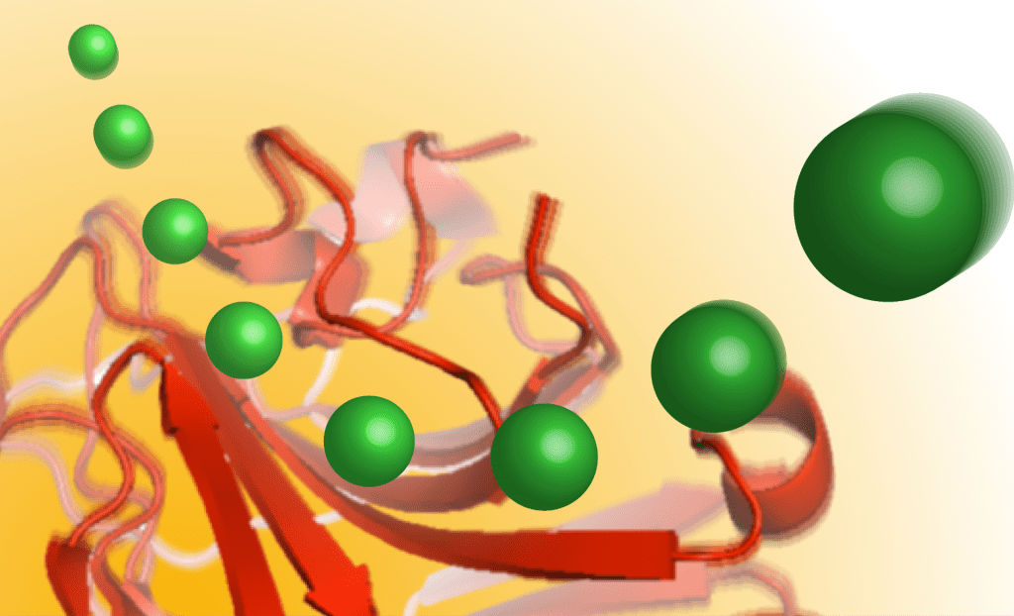
Collidoscope
James S. Prell
Department of Chemistry and Biochemistry
University of Oregon, Eugene, OR

Slide 2
Downloading and Installing Collidoscope
Go to github.com/prellgroup/Collidoscope
Download the latest version (currently coll_8_1_19.tar.gz),
then unzip it using your favorite program
Collidoscope works on LINUX (which we recommend!),
Windows (slightly more complicated to set up*), and MacOS
*for Windows, you’ll need to have a C++ compiler (recommended:
Visual Studio 2019, which is free from Microscoft) with Message
Passing Interface support—full instructions on our GitHub page!

Slide 3
After you have compiled the source code,
navigate to your Collidoscope folder

Slide 4
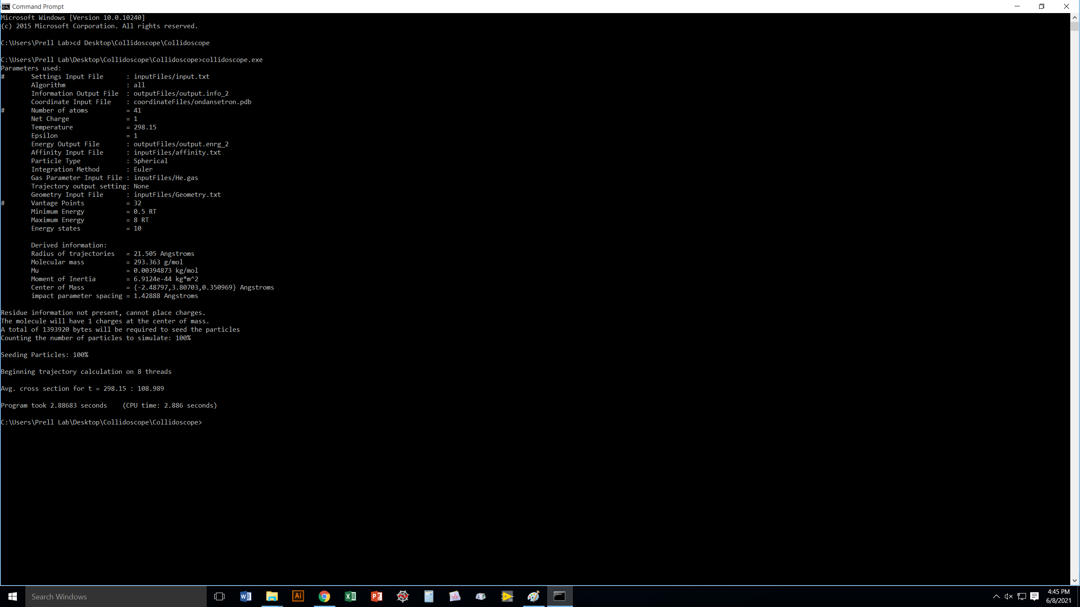
Simply type “collidoscope.exe” (Windows)
or ./coll (LINUX or MacOS) to run the default
computation for ondansetron¹⁺ in He.
You should get a value of 108.989 Å² if all
is working correctly.

Slide 5
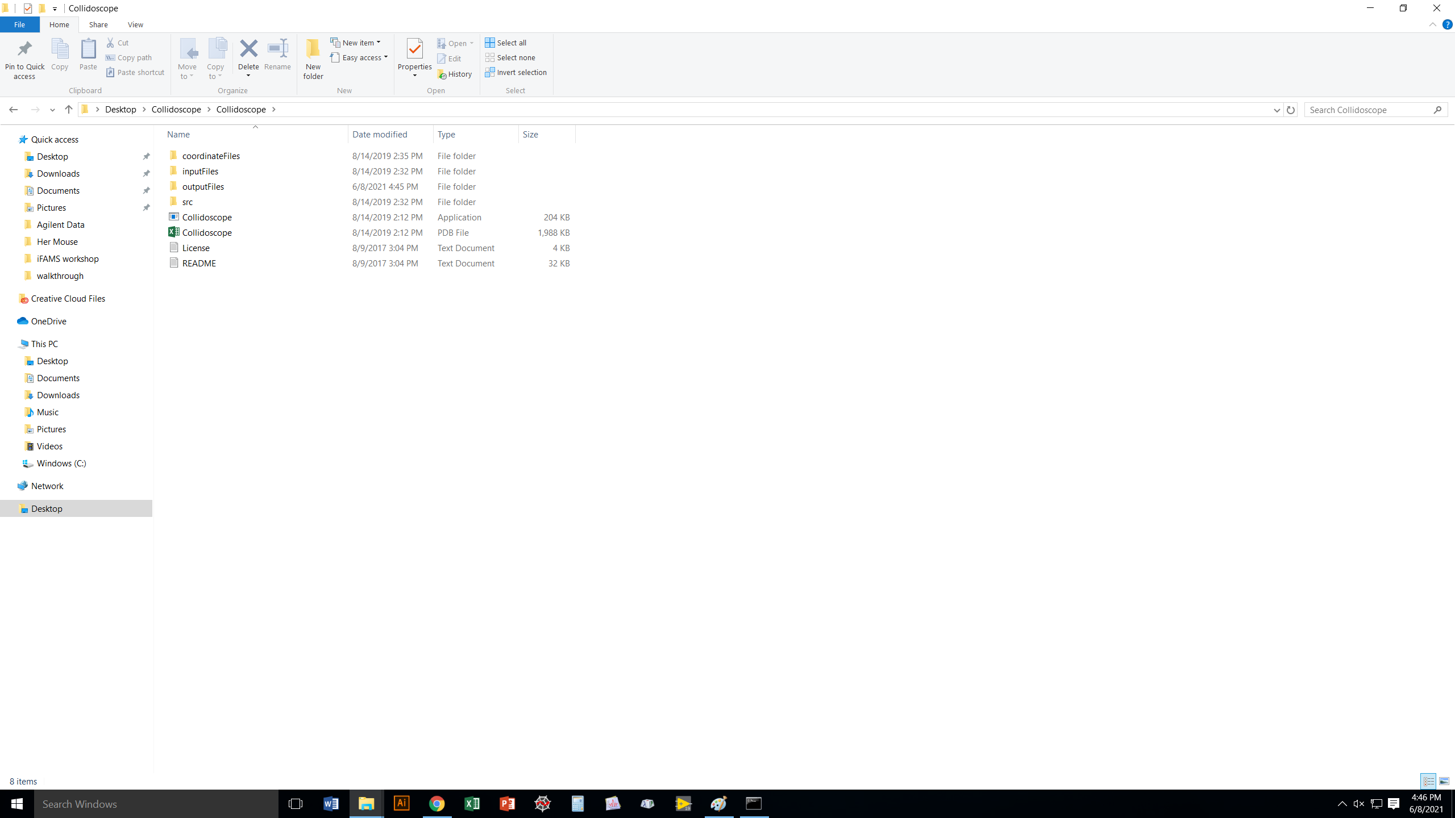
We’re going to take a look at what is in the files that
Collidoscope uses to operate.
Let’s start with the README!

Slide 6
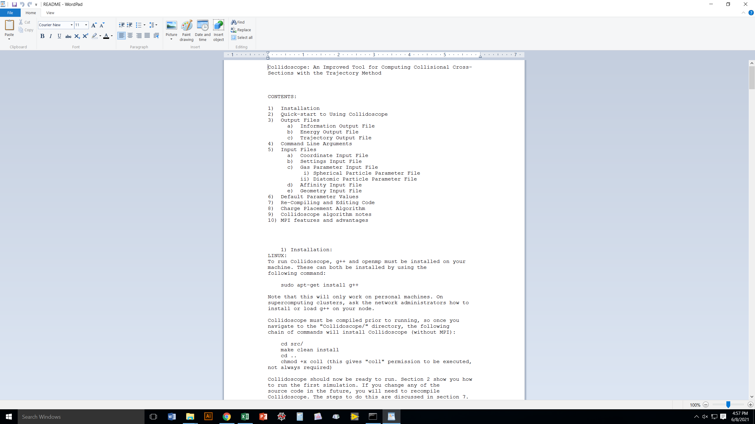
There’s a lot of helpful info
in the README, but let’s
jump to the Command Line
Arguments, which are what
you need to specify to run
a computation.

Slide 7
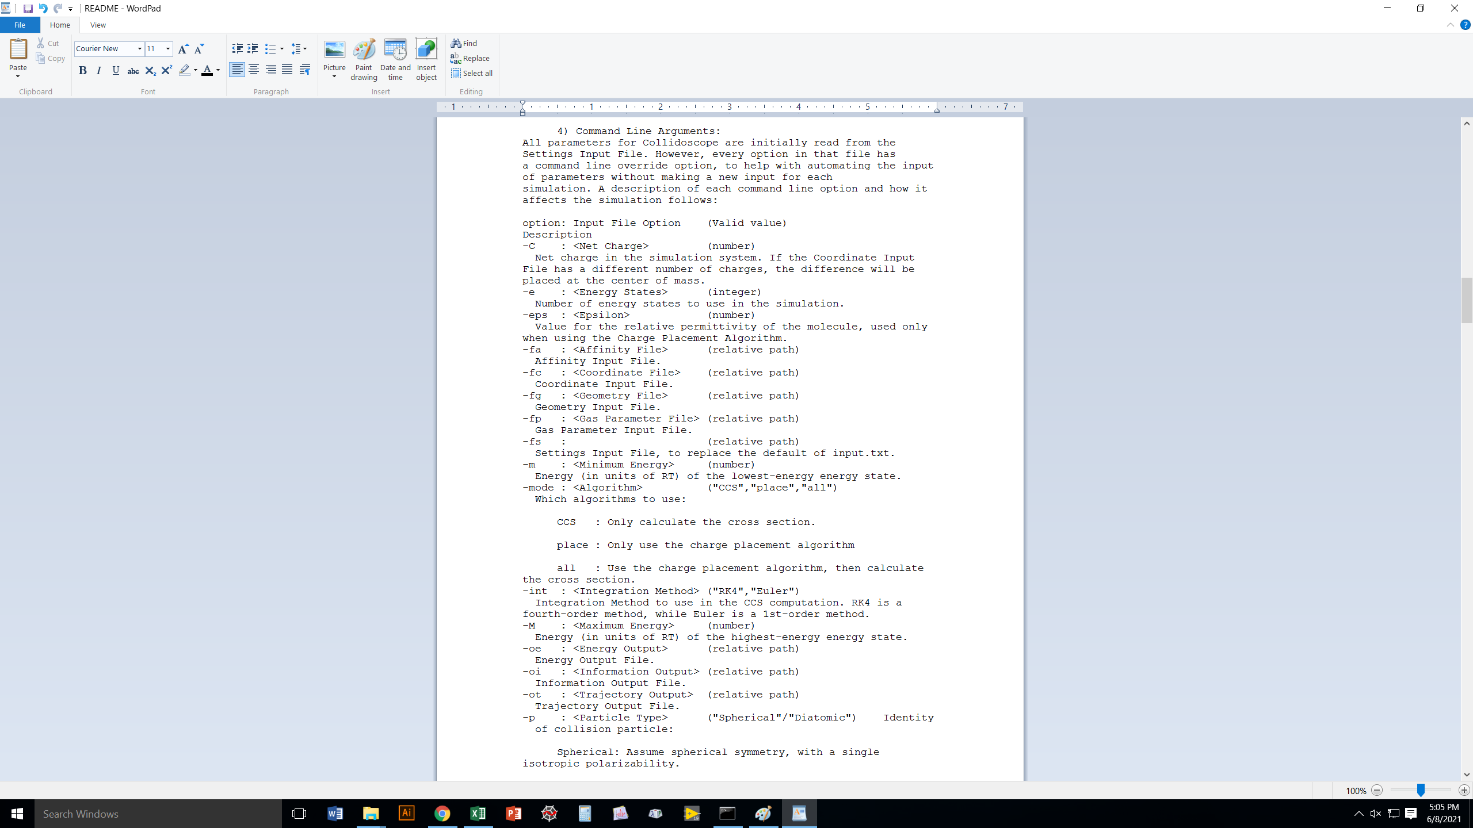
All of the Command Line Arguments
start with a dash (“-”), and you
always specify their value after the
tag,
e.g., “-e 20” means “use 20 energy states”
Also, they follow one after another on
the command line in any order:
“-e 20 -eps 4” will be interpreted the same
as “-eps 4 -e 20”

Slide 8
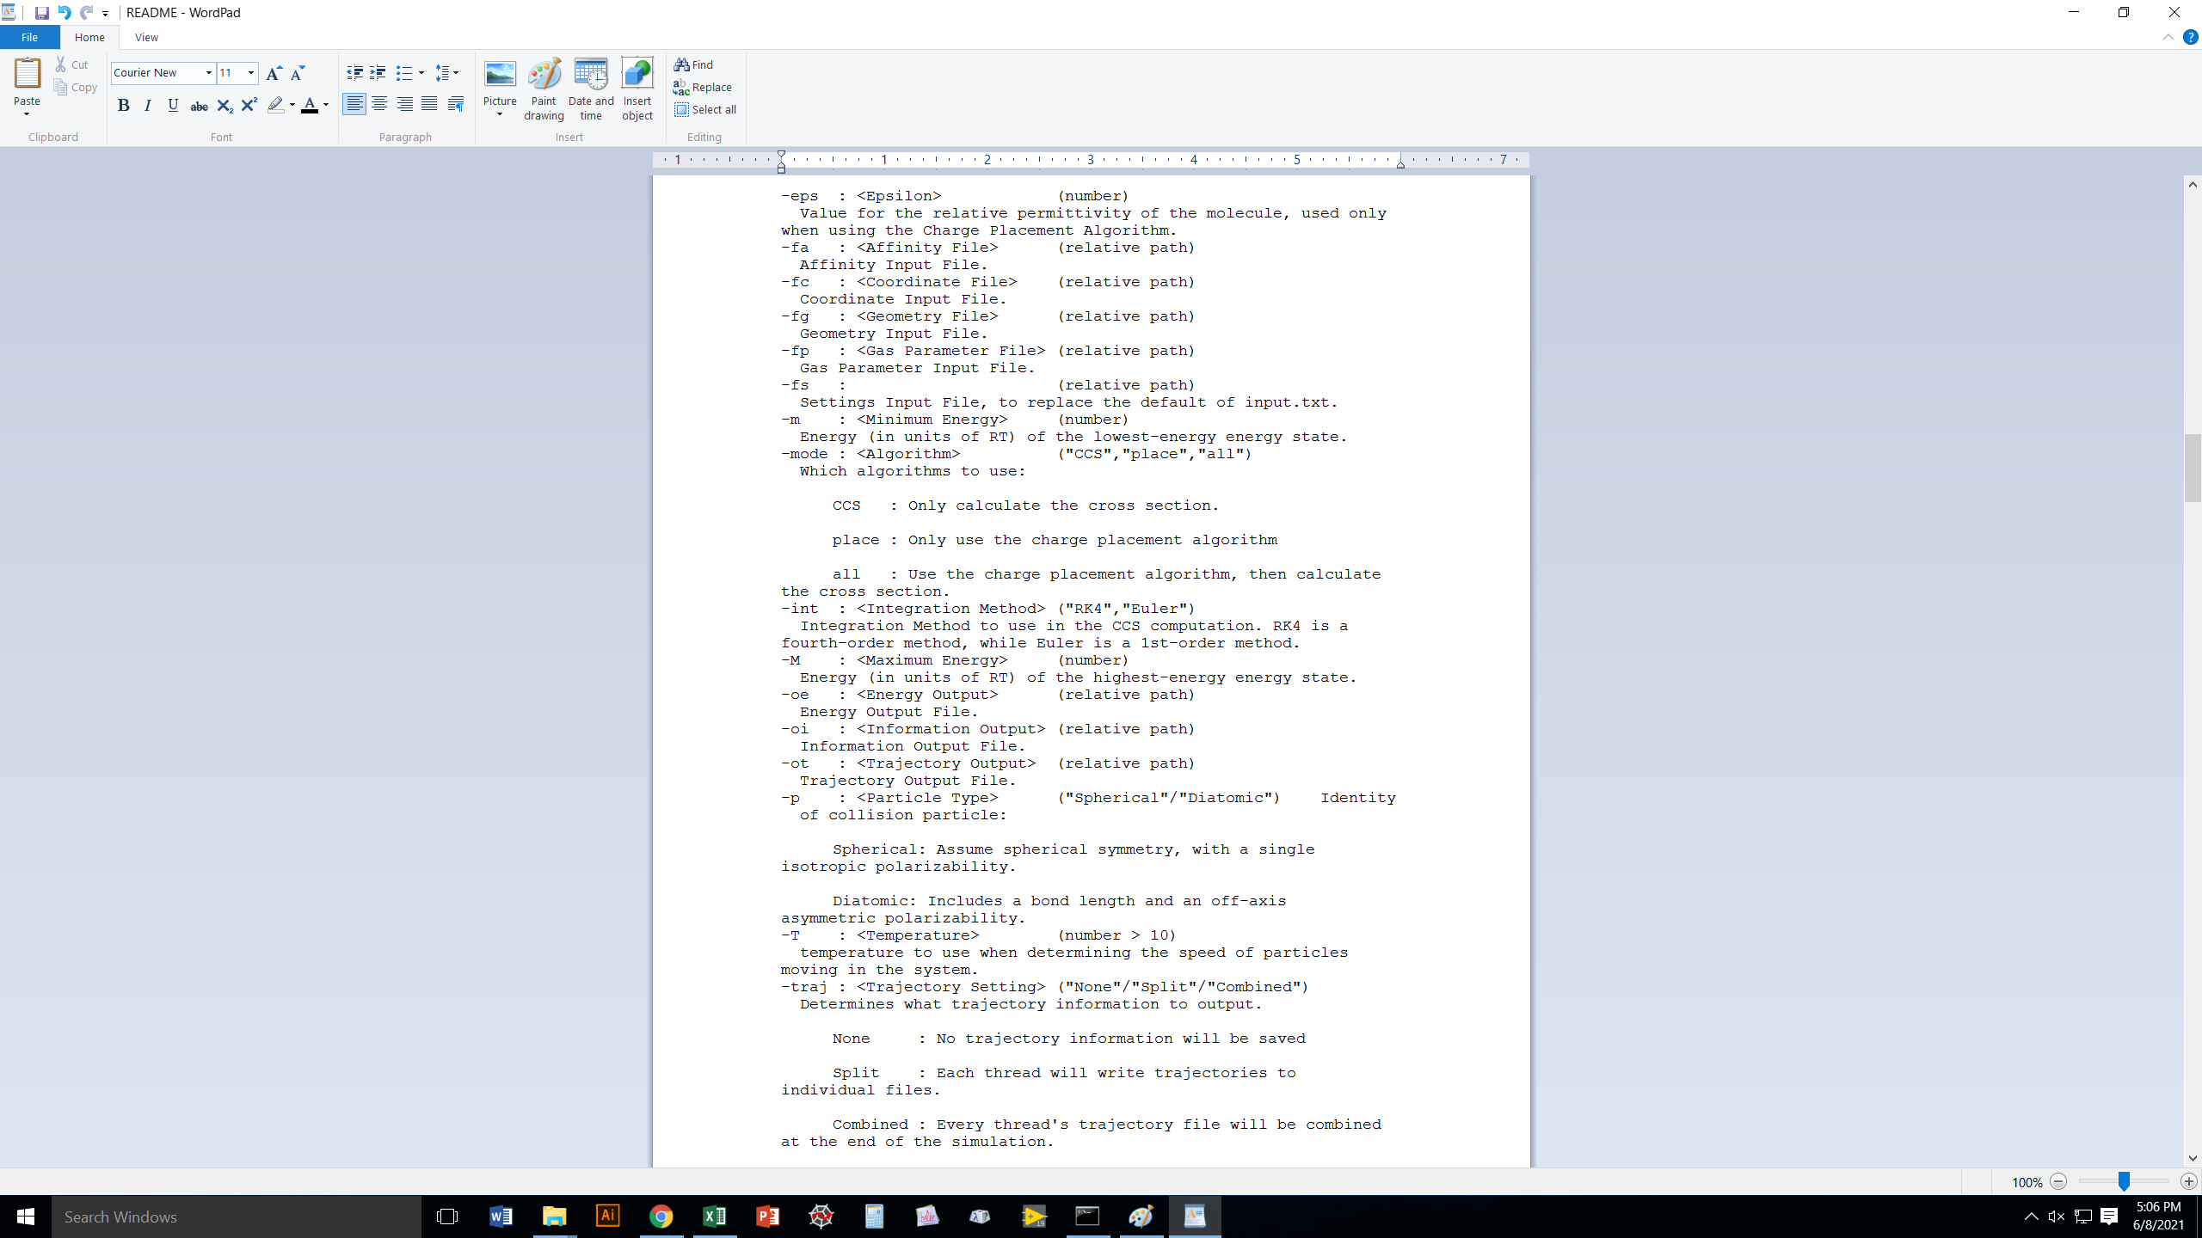
Collidoscope does a grand total of 3 basic things:
Place charges on a protein in a reasonably
low-energy configuration
Compute the CCS of an ion (Trajectory Method)
Both of the above, if you want, for a protein

Slide 9
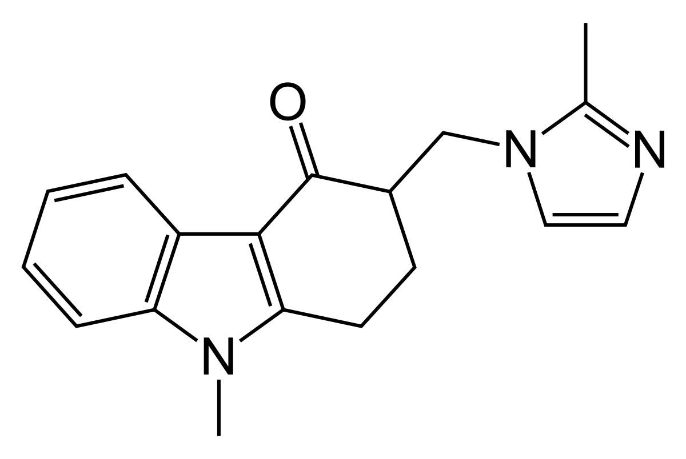
Let’s deal with proteins in a moment.
For now, let’s work with a small, singly-charged molecule:
ondansetron.

Slide 10
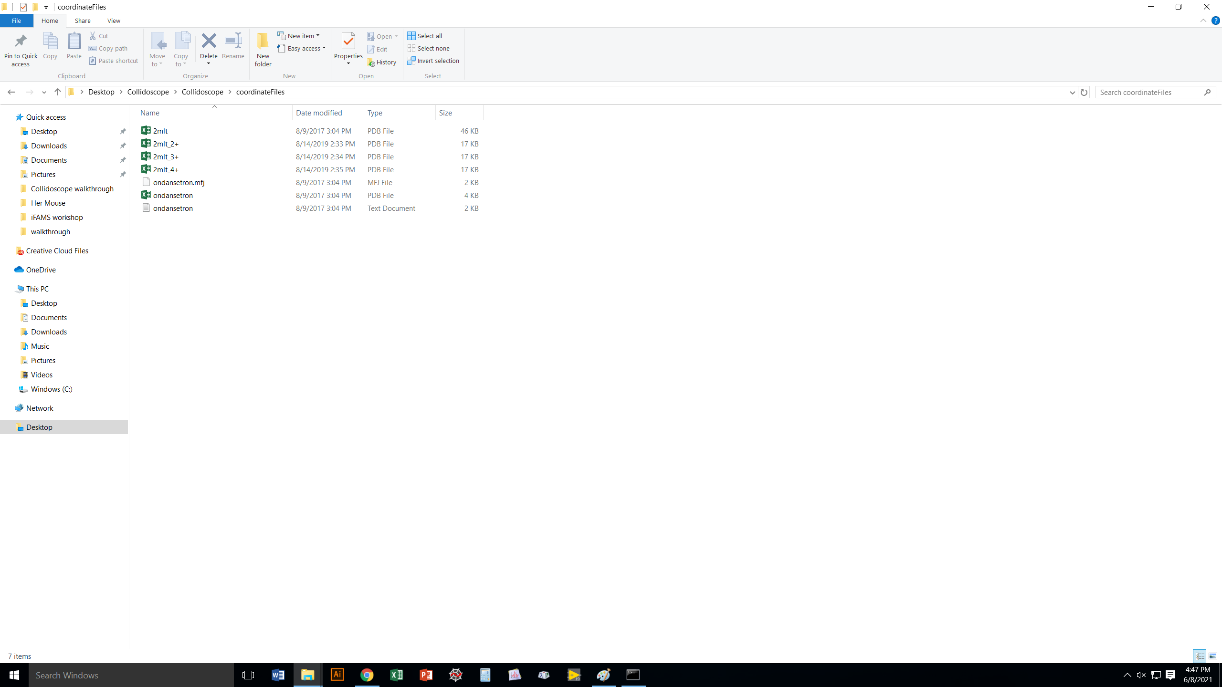
The coordinateFiles folder is where you should put the structures
you want to use Collidoscope on.
Collidoscope accepts two types of coordinate files as input:
pdb files
a simple text file format

Slide 11
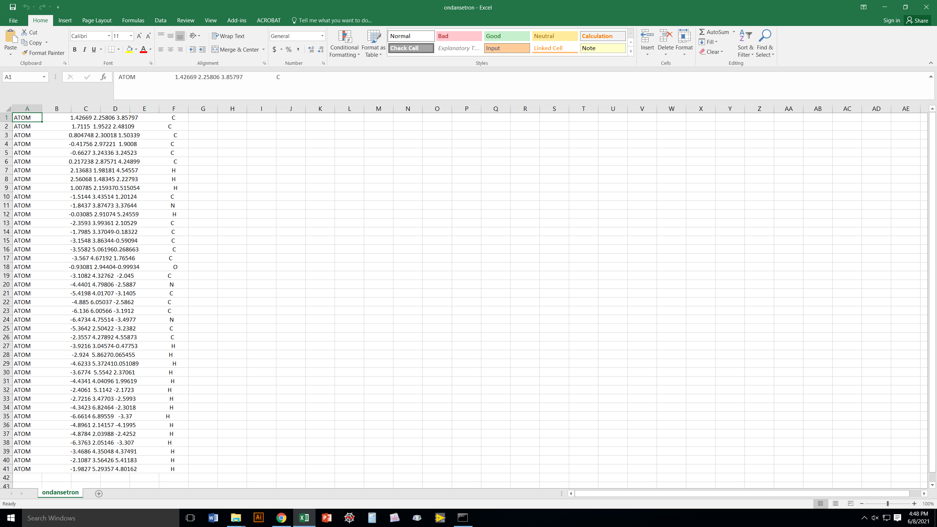
Here’s the pdb file for ondansetron.
Coordinates are x, y, z in Å.
Note that it lacks a lot of the information
you would expect in a pdb for an actual protein.

Slide 12
Here is the basic txt format file for ondansetron.
If you want, you can add your own column at the end
with partial charges (e.g., from an ab initio computation)
if you want to get extra fancy.
Coordinates are x, y, z in Å.

Slide 13
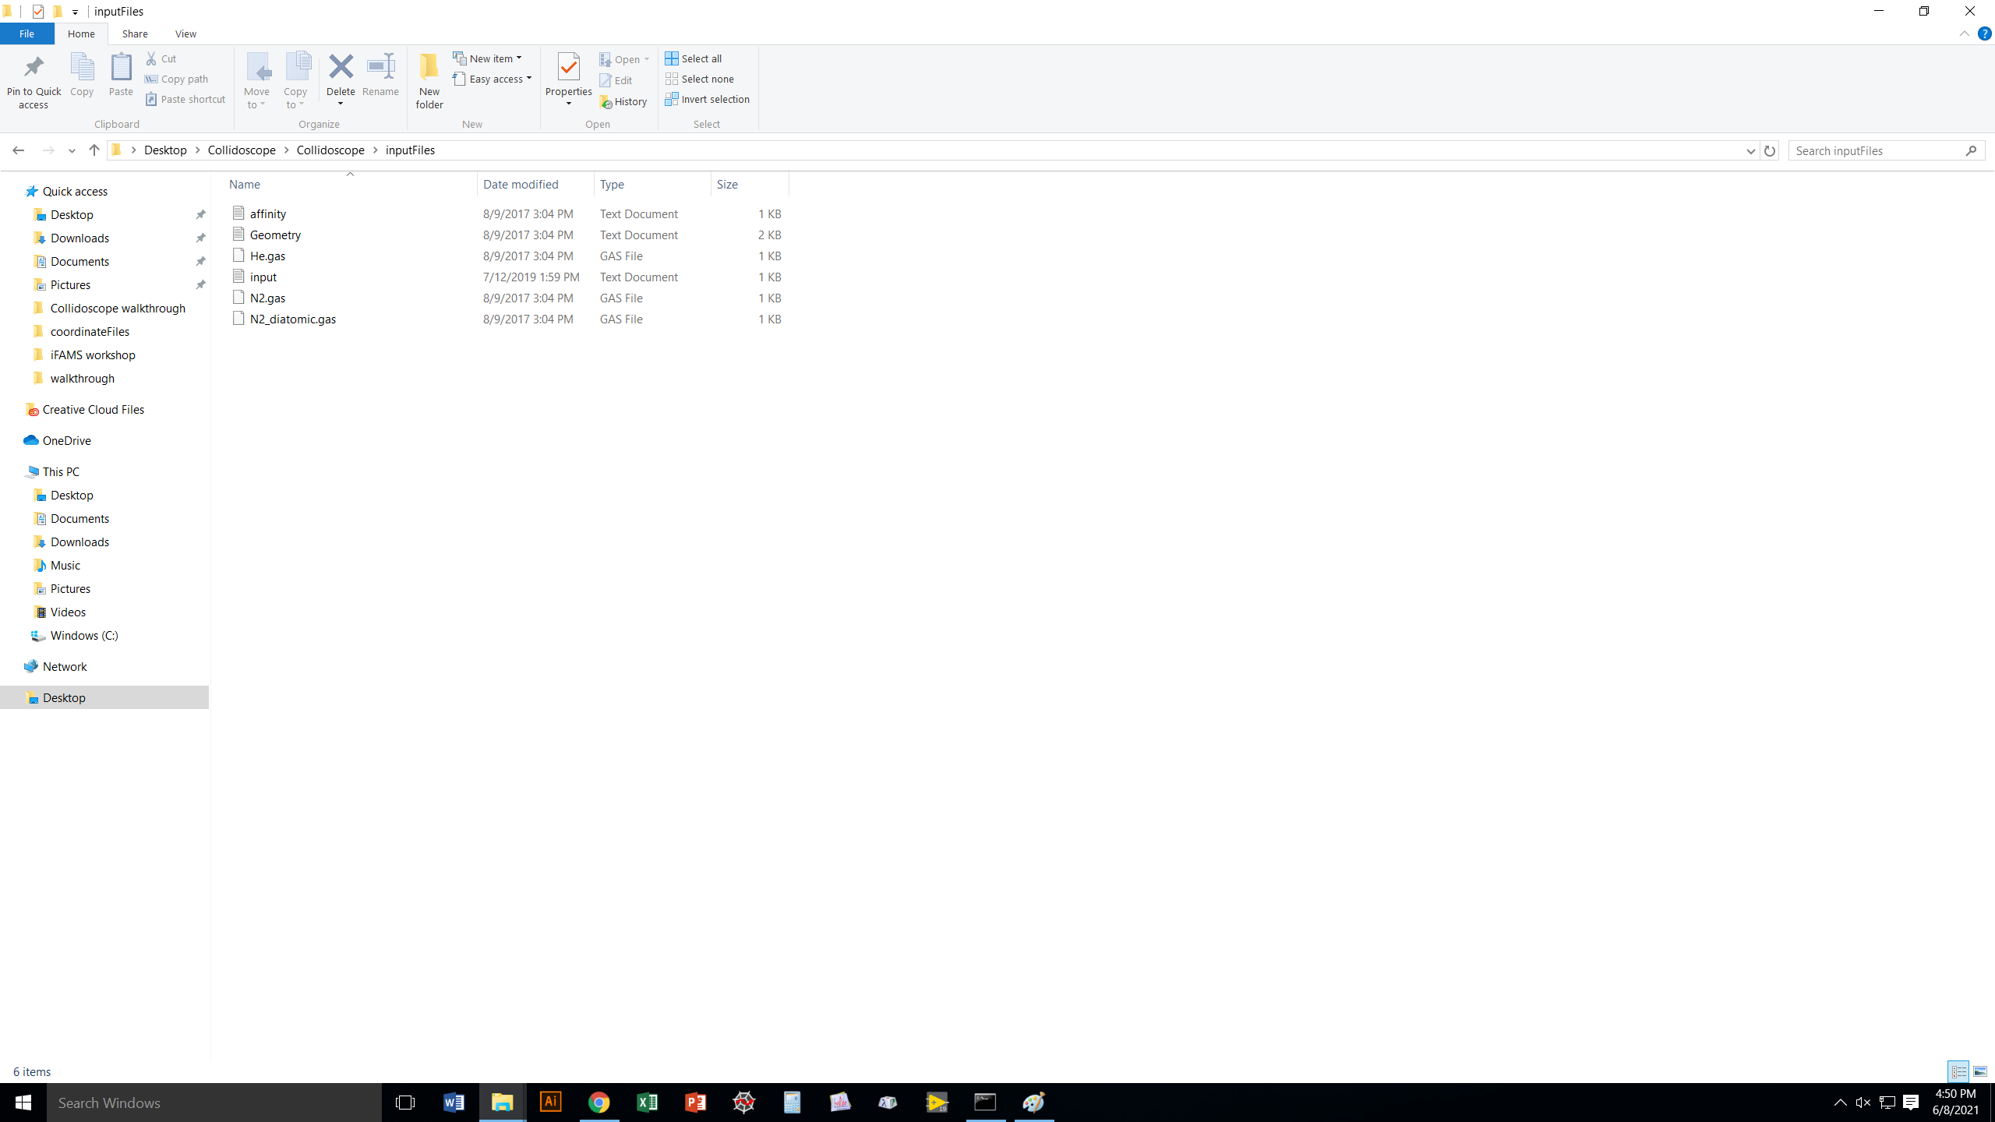
The inputFiles folder contains files you don’t typically touch.
They include:
“affinity” (we’ll talk about that when we get to proteins)
Geometry (angles your molecule gets rotate into for CCS
computations)
Gas files (He and N₂), which in part determine interaction
potentials
“input”, which contains a bunch of other default values
that Collidoscope calls when it runs

Slide 14
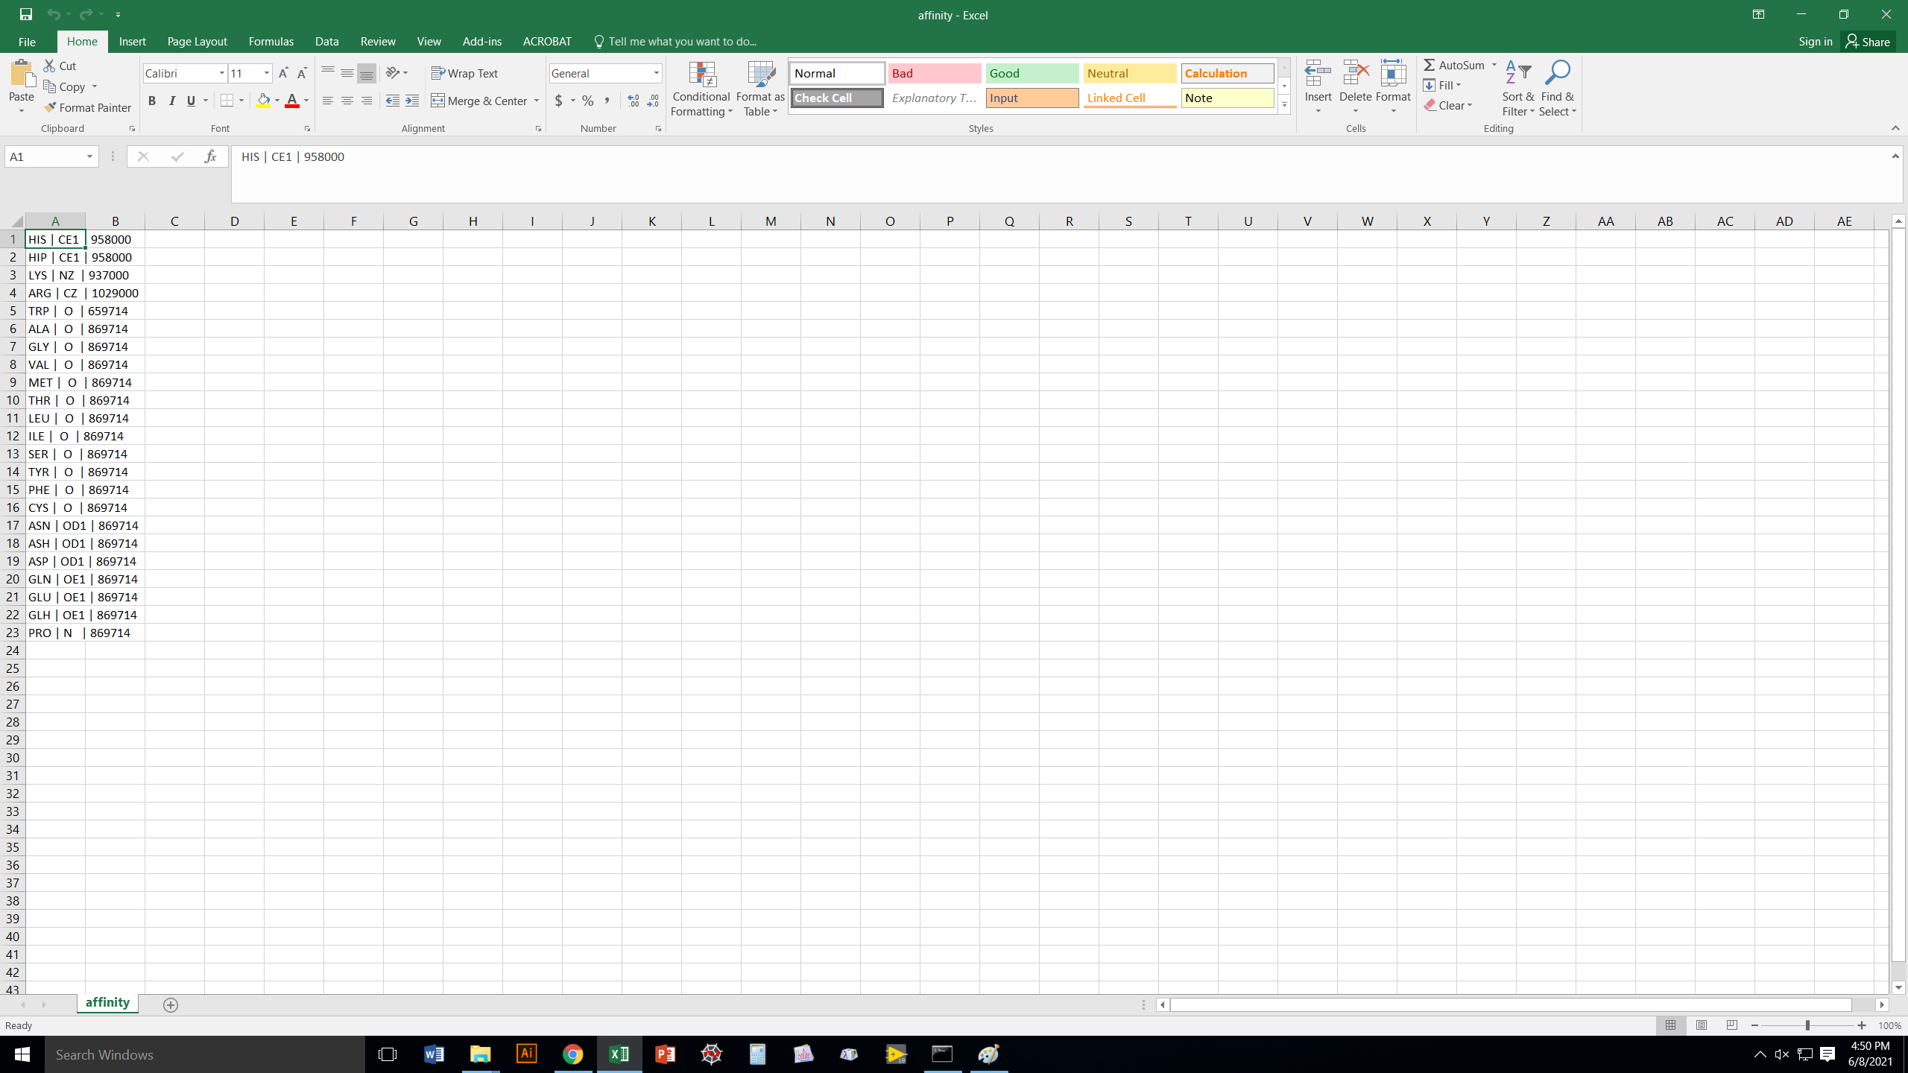
These are Proton Affinity values, which help determine
which residues on your protein are most likely to be
protonated in the gas phase.
They also tell you which atom in a residue is going to
hold the charge for the purposes of the CCS computation.
Don’t touch anything here unless you are very familiar
with gas-phase protonation thermochemistry.

Slide 15
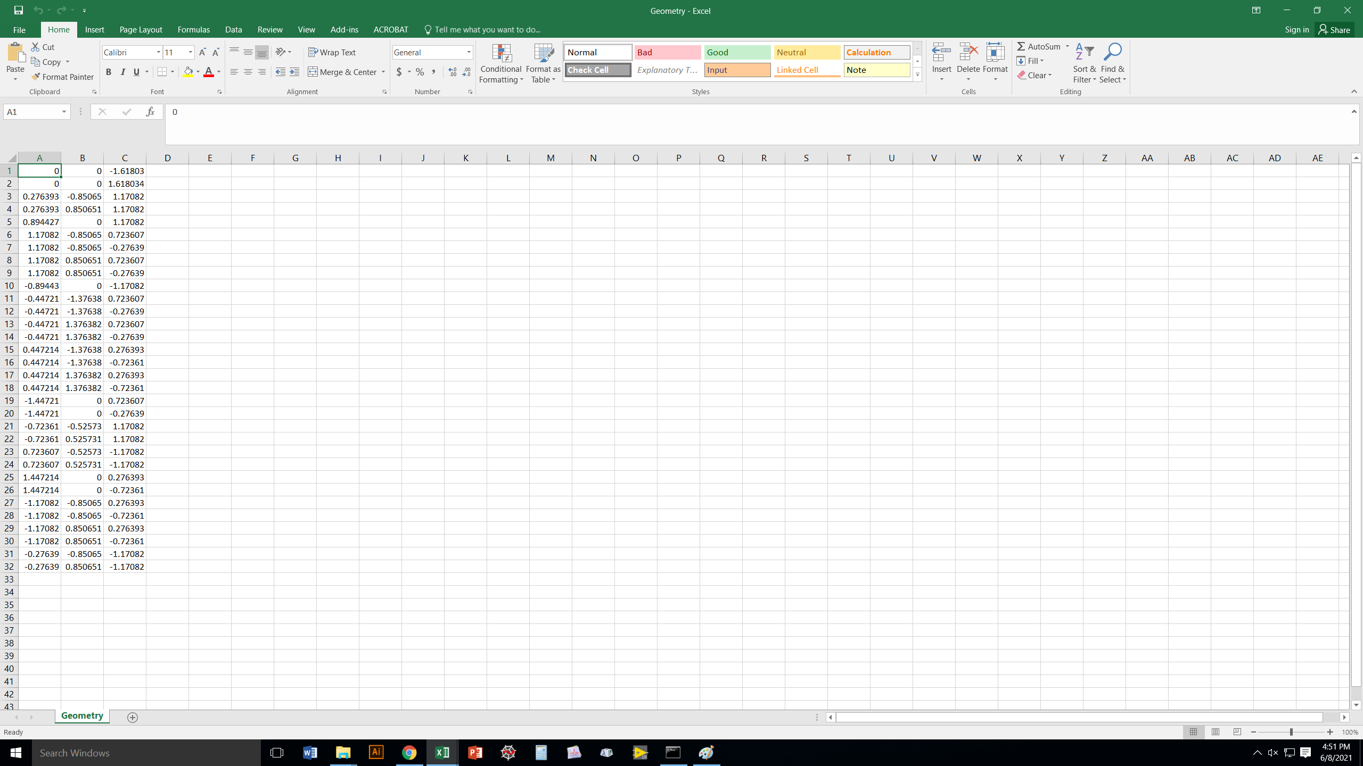
These are points on a 32-sided polyhedron.
They assure that all the possible orientations
of your ion are well sampled in the CCS computation.
(We tested a lot of different possibilities and found this
gives virtually identical results to a very thorough
Monte Carlo simulation using random orientations.)

Slide 16
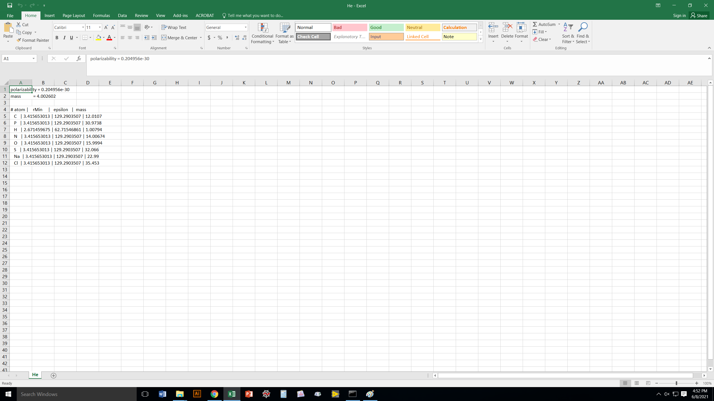
Polarizability (here, in m³) determines long-range
ion-dipole interactions.
The Lennard-Jones 6-12 parameters are in
Å (rMin) and J/mol (epsilon); these determine short-
and medium-range interactions.
For He, these values are identical to MOBCAL.
Don’t change them unless you know what you are doing.

Slide 17
Interaction potential parameters for N2 gas
assume it is equivalent to a sphere.
These values were co-optimized for a large group
of small organic ions.

Slide 18
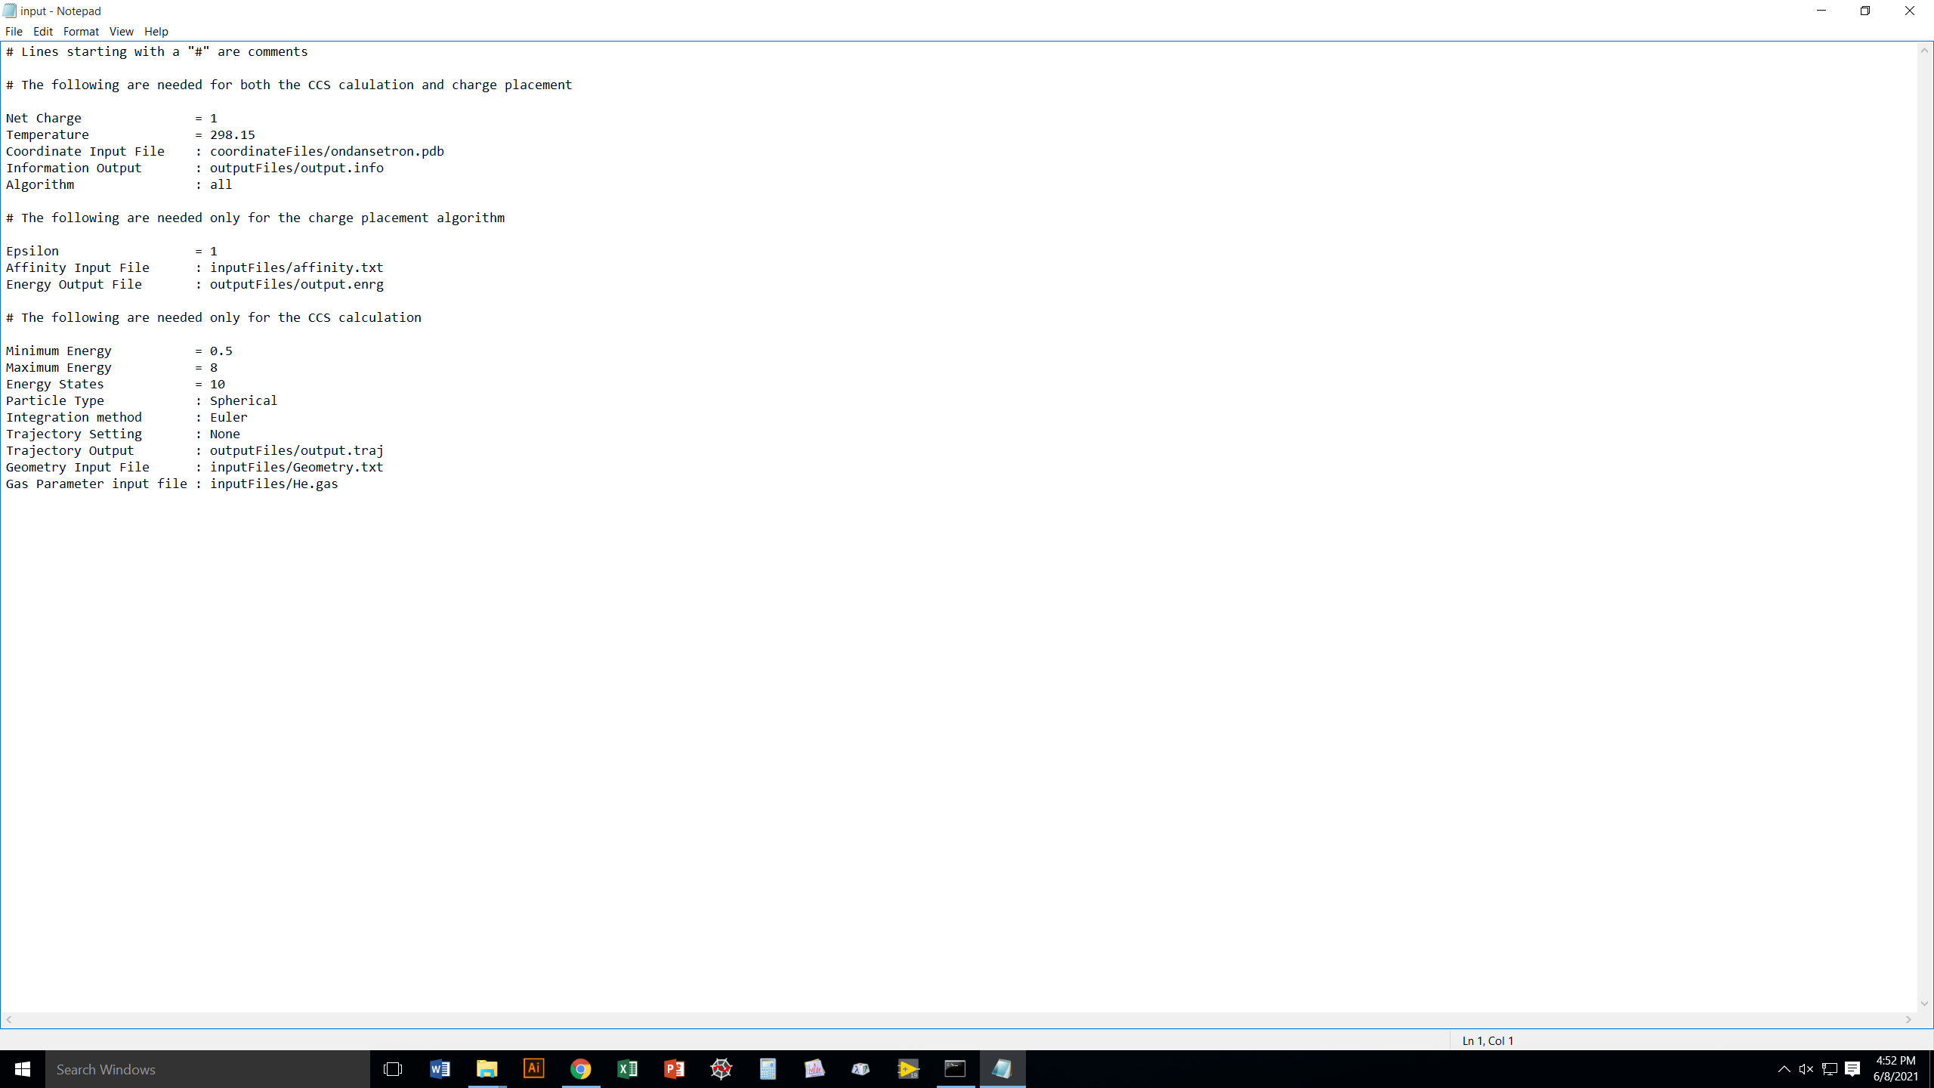
The “input” file in the inputFiles folder simply
feeds default values into Collidoscope to save
you the effort of manually entering them all.
Anything you type in at the command line yourself
will override these defaults, but the others will
be left untouched.

Slide 19
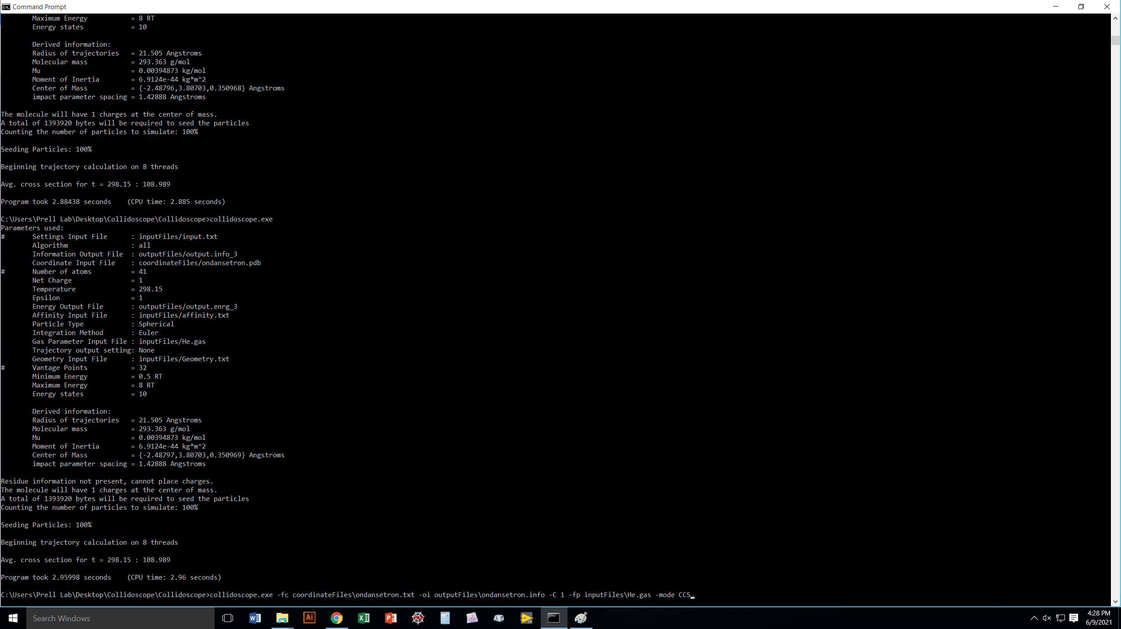
Type this in to calculate the CCS of ondansetron¹⁺ and output the result to ondansetron.info

Slide 20
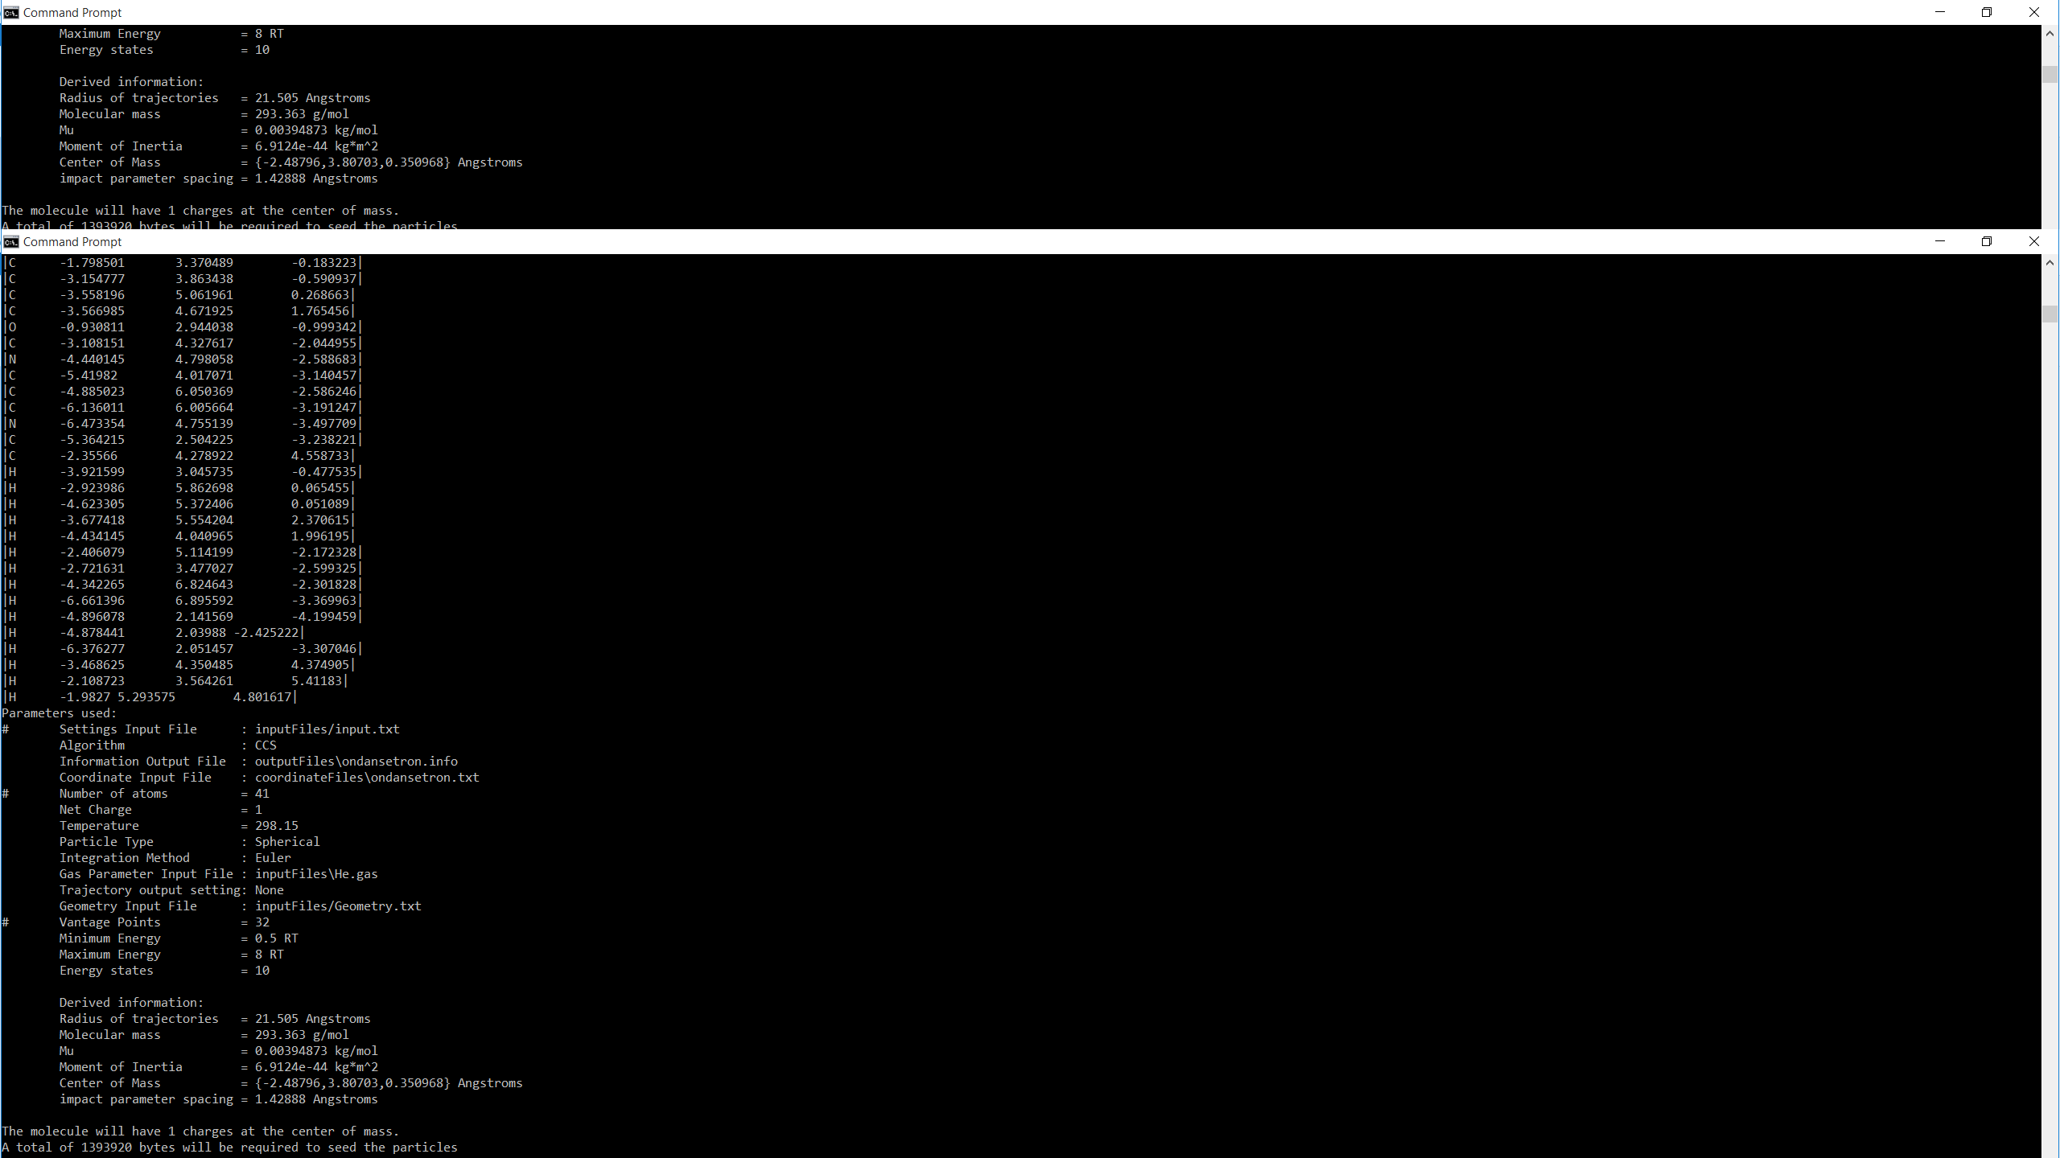
Collidoscope will start outputting information to the screen,
but don’t worry, everything will be saved to the output file
you specified a moment ago!

Slide 21
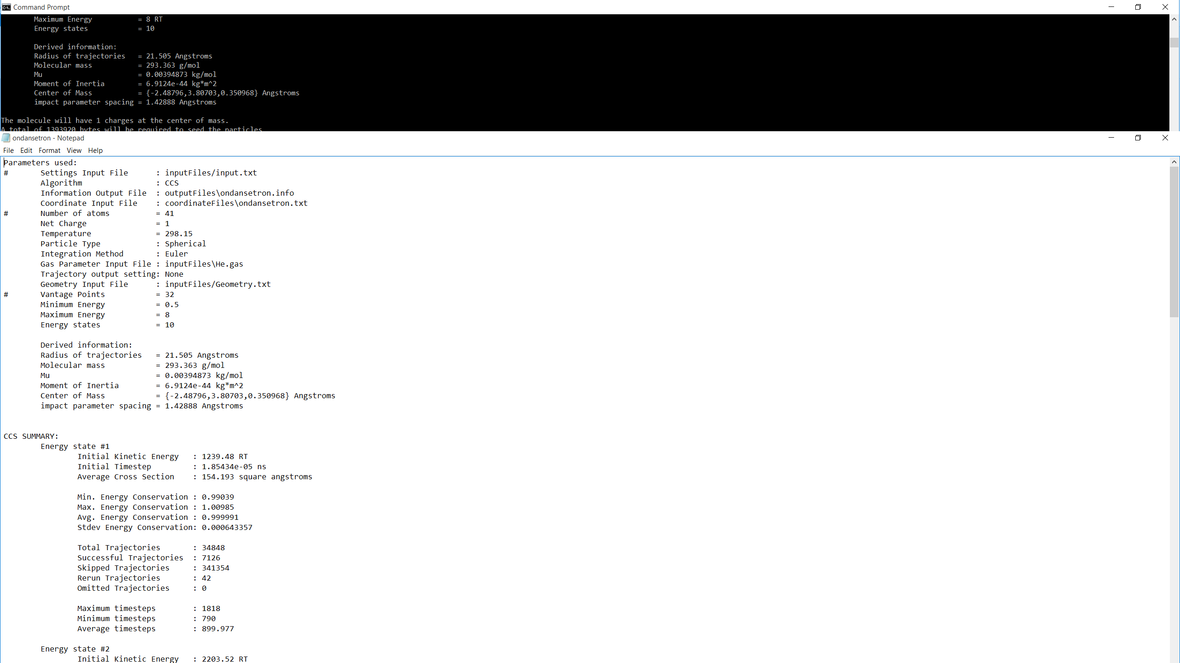
The output file goes wherever you told Collidoscope
to put it.
It also spits back out the parameter values used or
the files that contain them.
At the bottom, we see detailed results for each energy
stated. These are Boltzmann-averaged to get the
final CCS value.

Slide 22
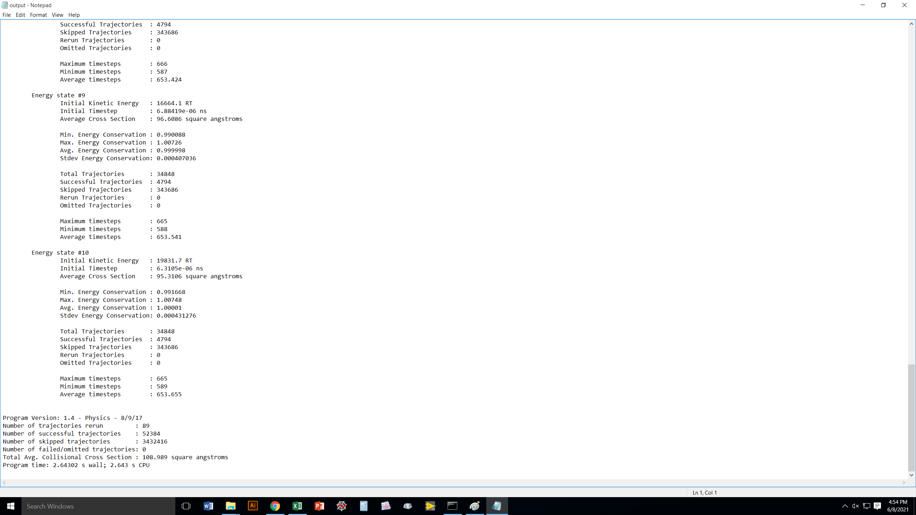
Same answer we got before! Whew!

Slide 23
Now let’s see how we do things for a protein: melittin.

Slide 24
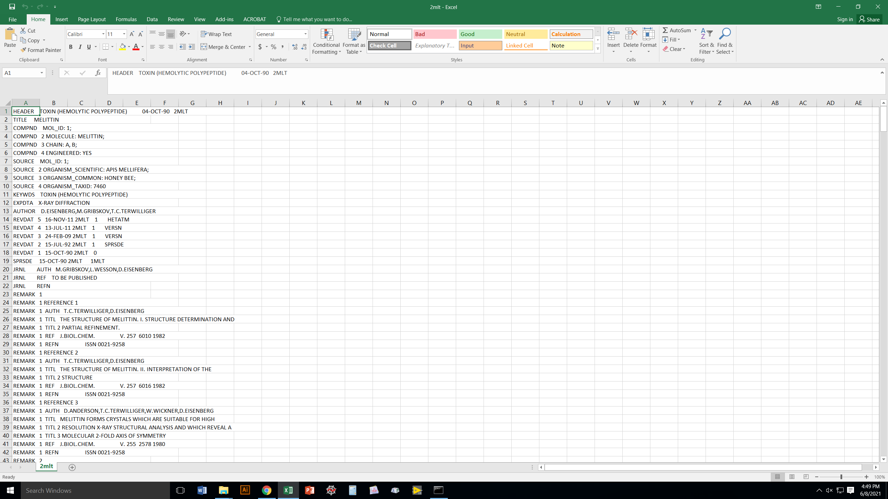
For melittin³⁺, we will start with its pdb file, 2mlt.
You can often just download pdb files from your
favorite pdb repository, BUT be careful that they
May be missing residues
May have partial occupancies for some atoms
May have water, salt, or other molecules
You can fix these things manually, or we have a
“pdbcleaner” program we can send to you.

Slide 25
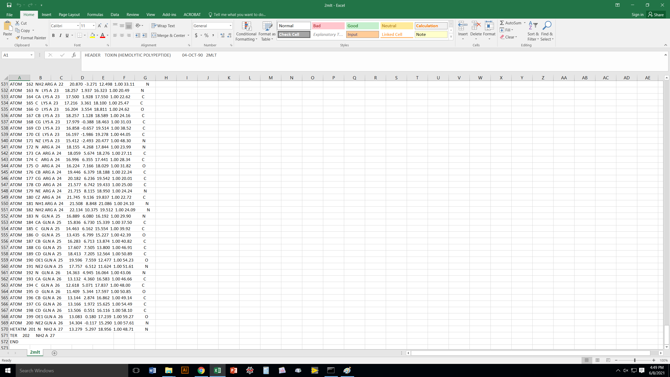

Slide 26
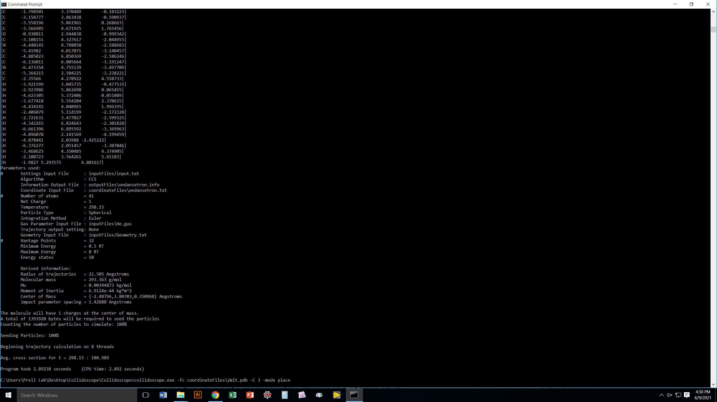
If all you want to do is place 3 charges onto melittin (no CCS calculation),
here is what you enter at the command line.

Slide 27
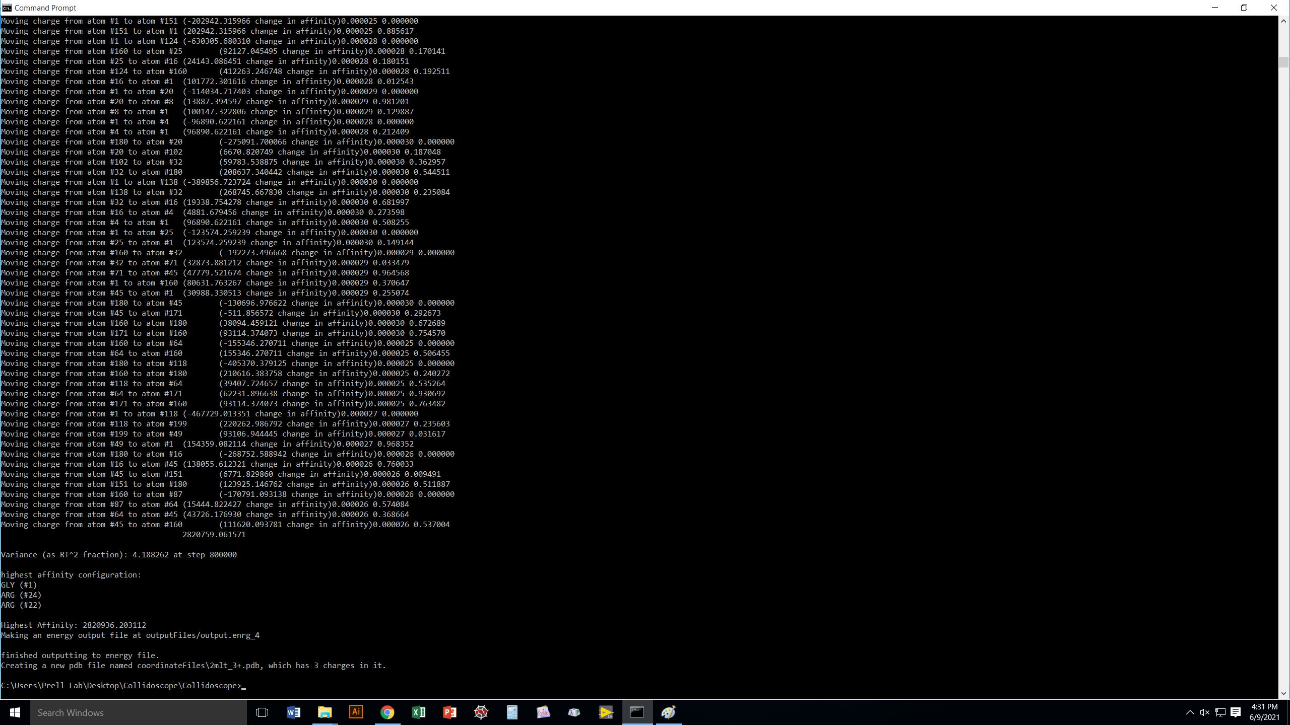
Collidoscope moves the charges around randomly until they find a very
stable configuration.
Apparently, the best configuration was to place a proton at the
N-terminus (Gly1) and Arg22 and Arg24.
You can also see where the resulting new pdb file, including the charges,
has been stored.

Slide 28
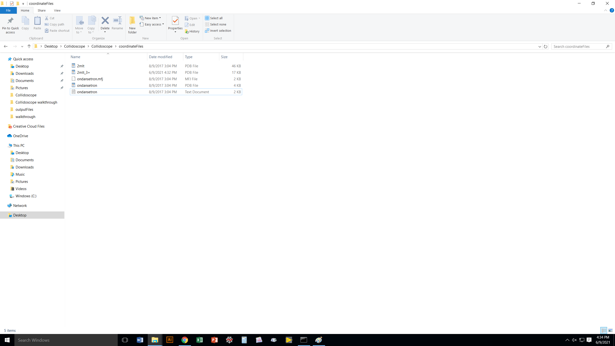
Here’s our brand new melittin³⁺ pdb file!
You can now do whatever you want with it, including use it as input
for a CCS calculation.

Slide 29
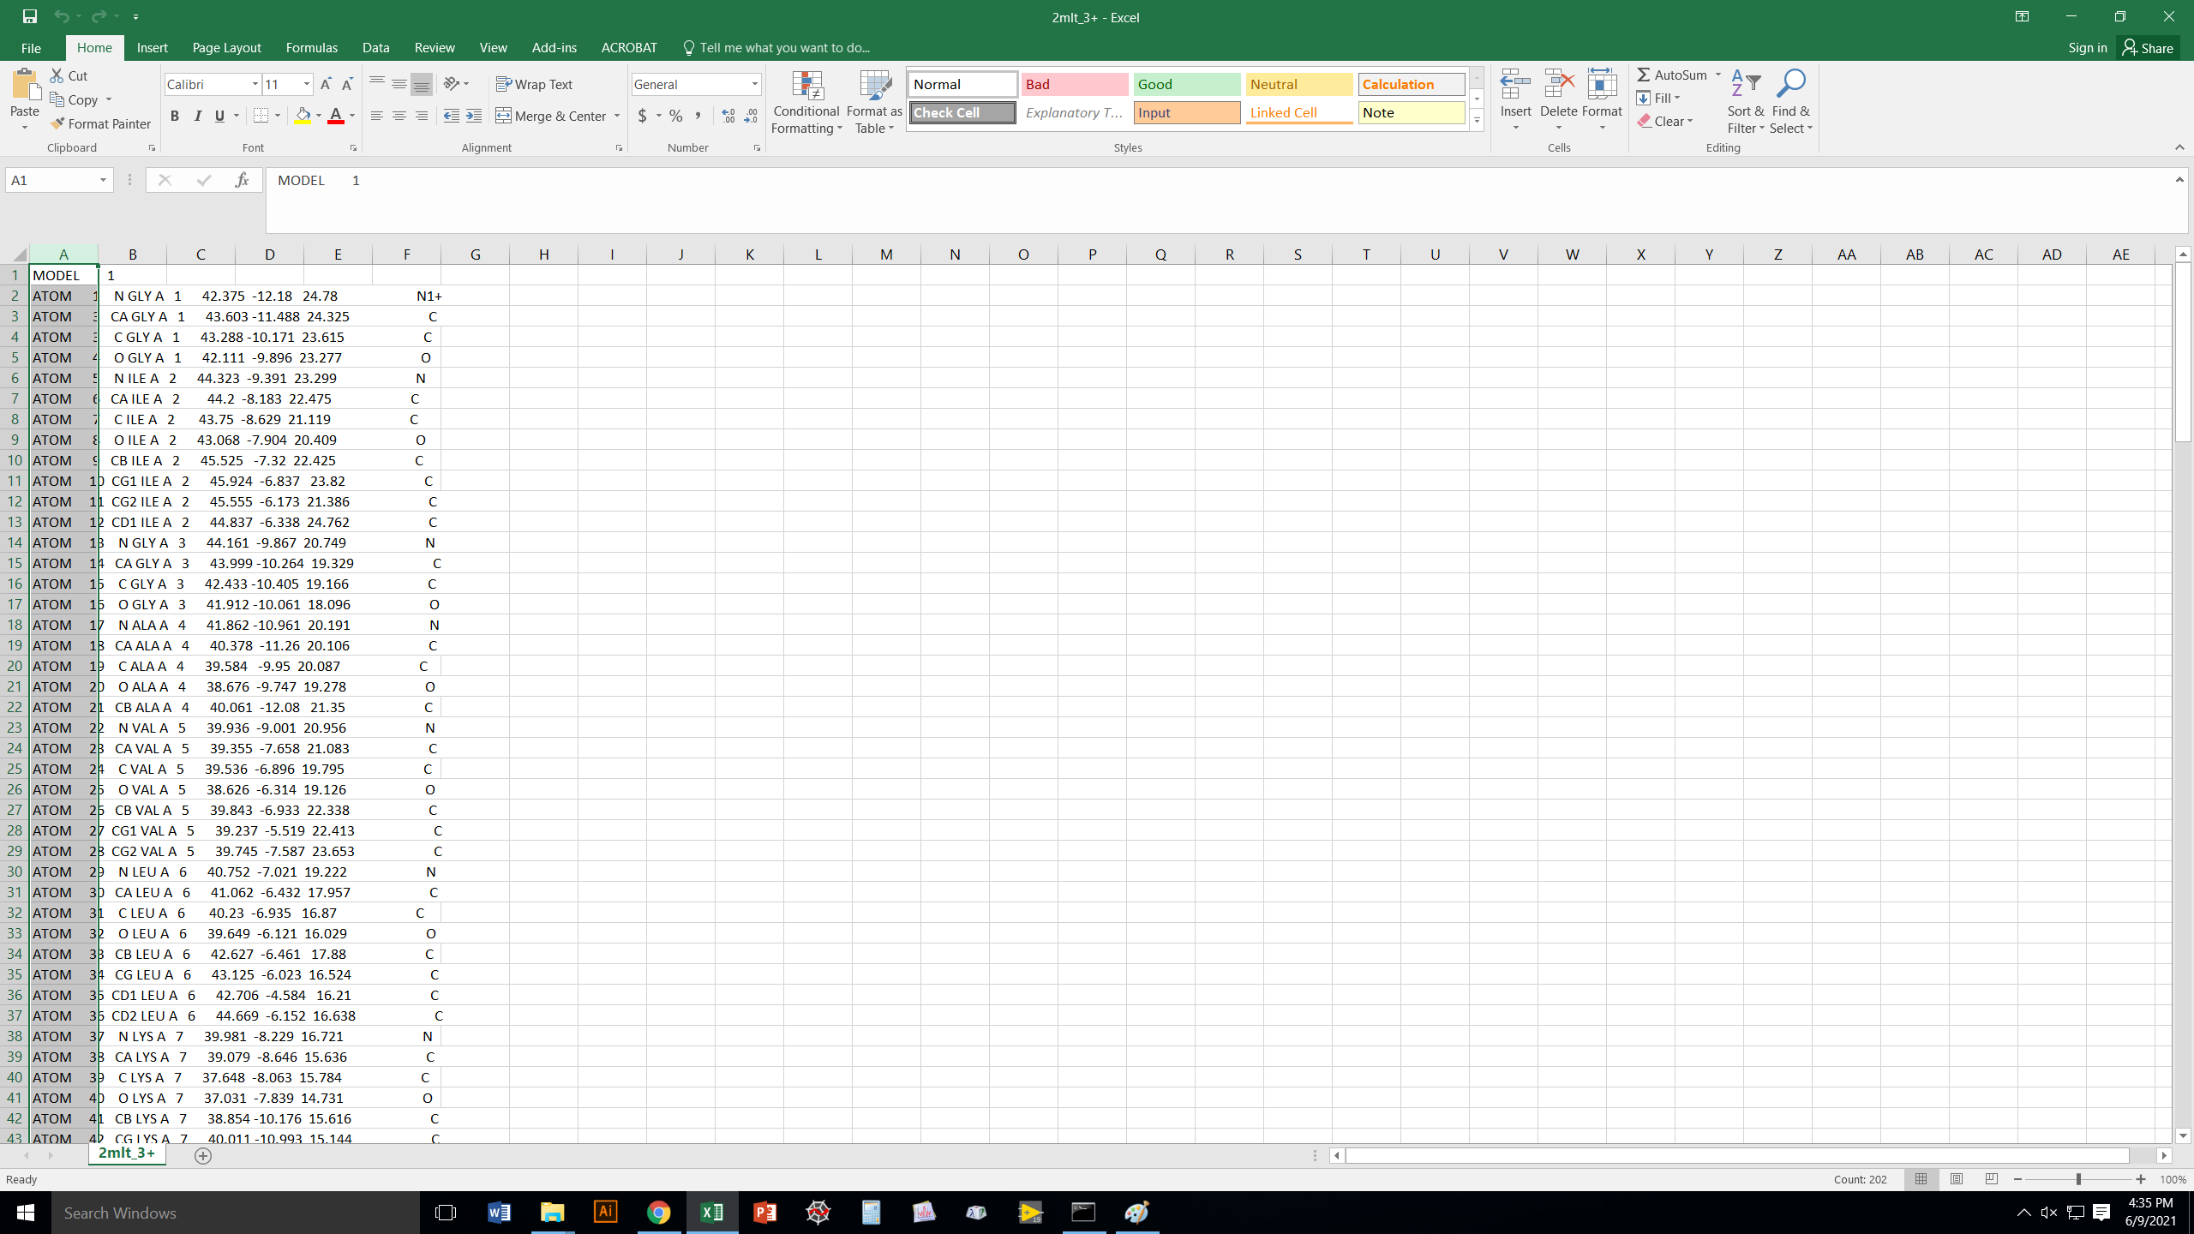
The melittin3+ file we just created using “place” has put charges
on the residues it said it would.

Slide 30
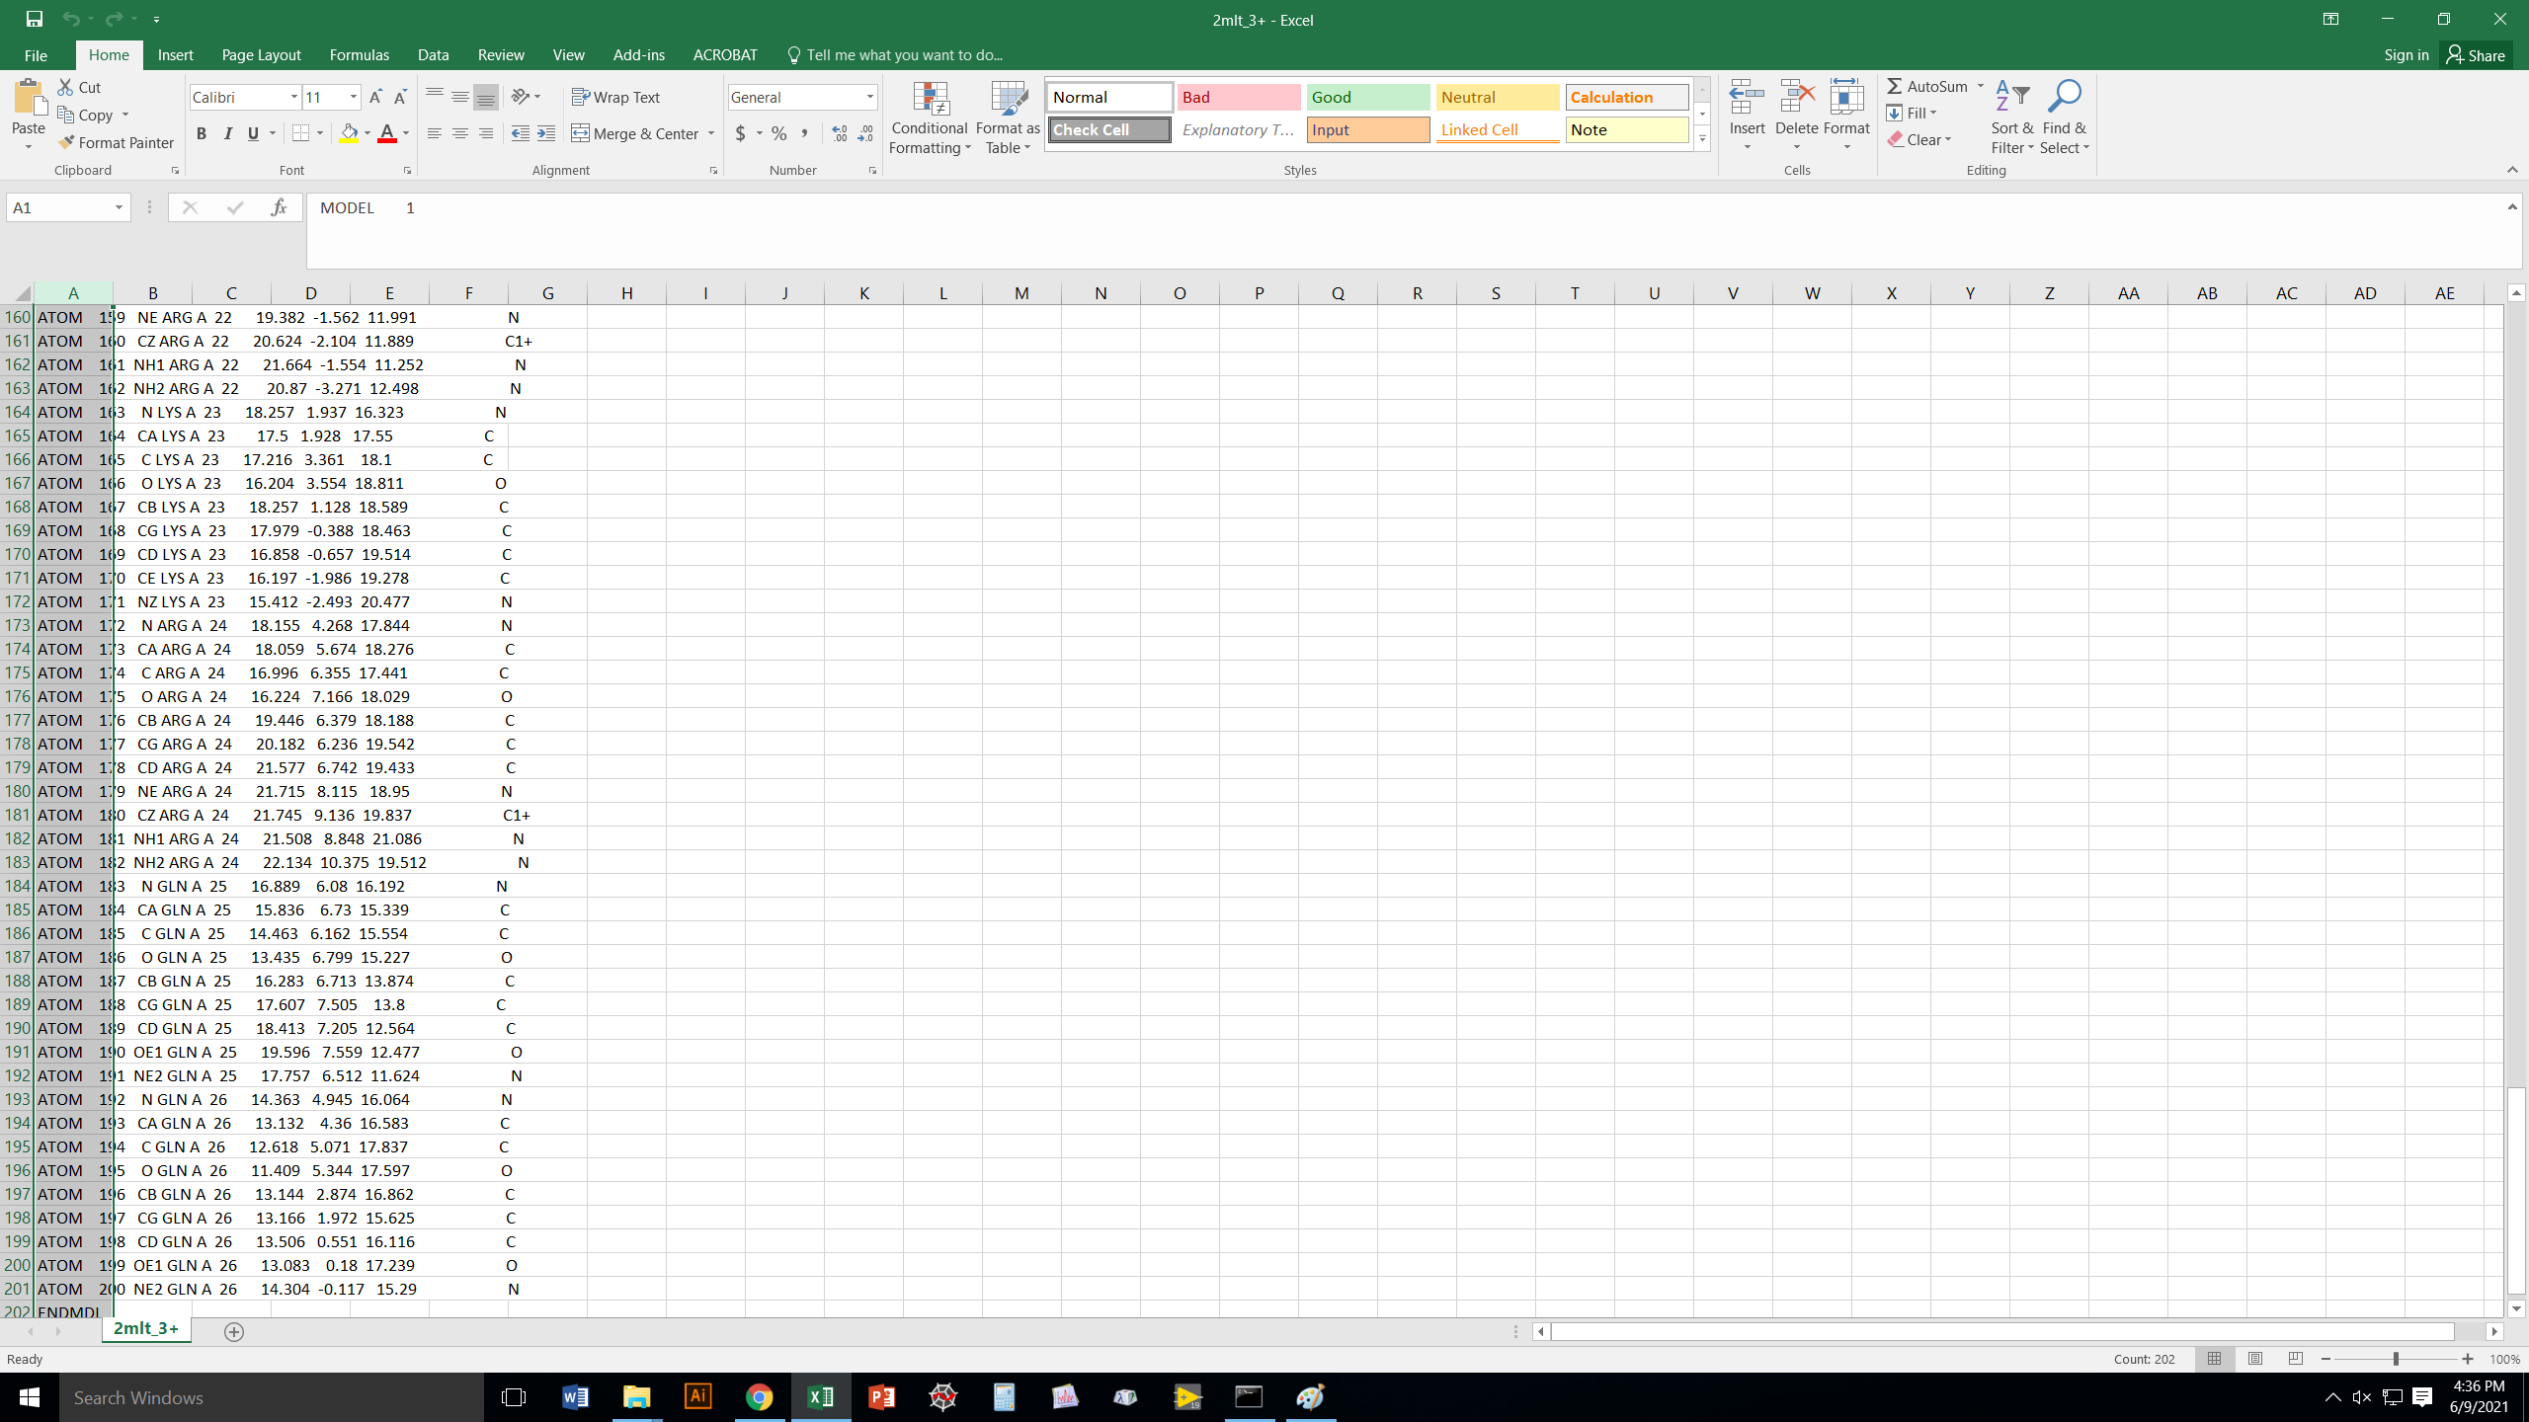
The melittin3+ file we just created using “place” has put charges
on the residues it said it would.

Slide 31
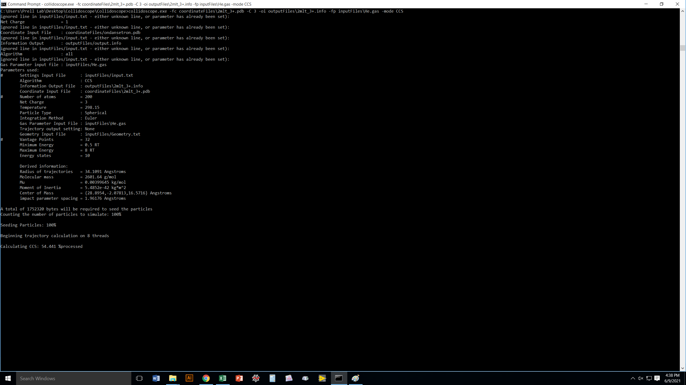
Now we’re telling Collidoscope to use the pdb file we just created
(melittin³⁺) as input for a CCS calculation.
Note that, unlike for the “place” routine, you do have to specify
and output file name for this!

Slide 32
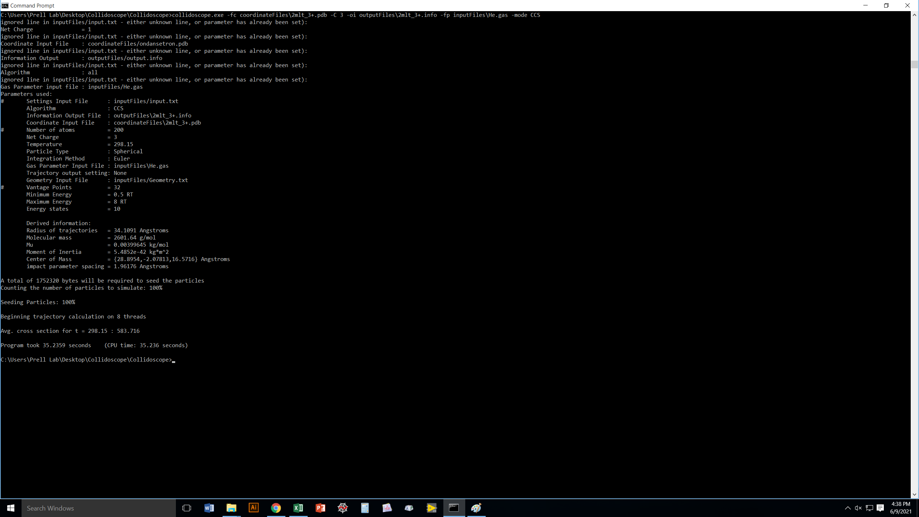
It worked! Notice it obviously took a bit longer than
ondansetron, because melittin is bigger.

Slide 33
But you may prefer just to run “place” and “CCS” together,
with Collidoscope automatically feeding the results of “place”
into the “CCS” routine.
You do this by using the “–mode all” flag on the original pdb
structure.

Slide 34
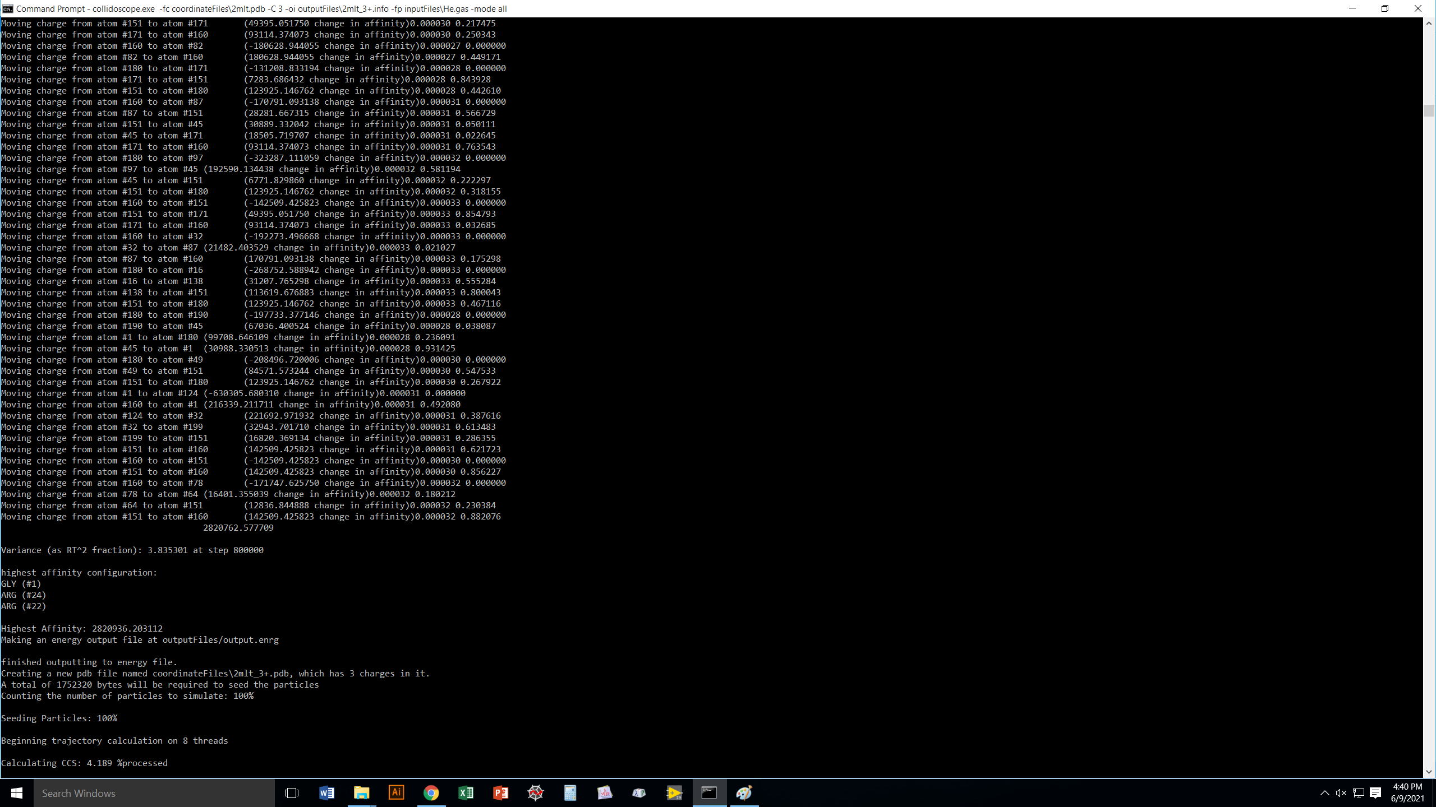
Notice how, in “all” mode, Collidoscope immediately starts
working on the CCS calculation as soon as it finishes the “place”
part of the routine.

Slide 35
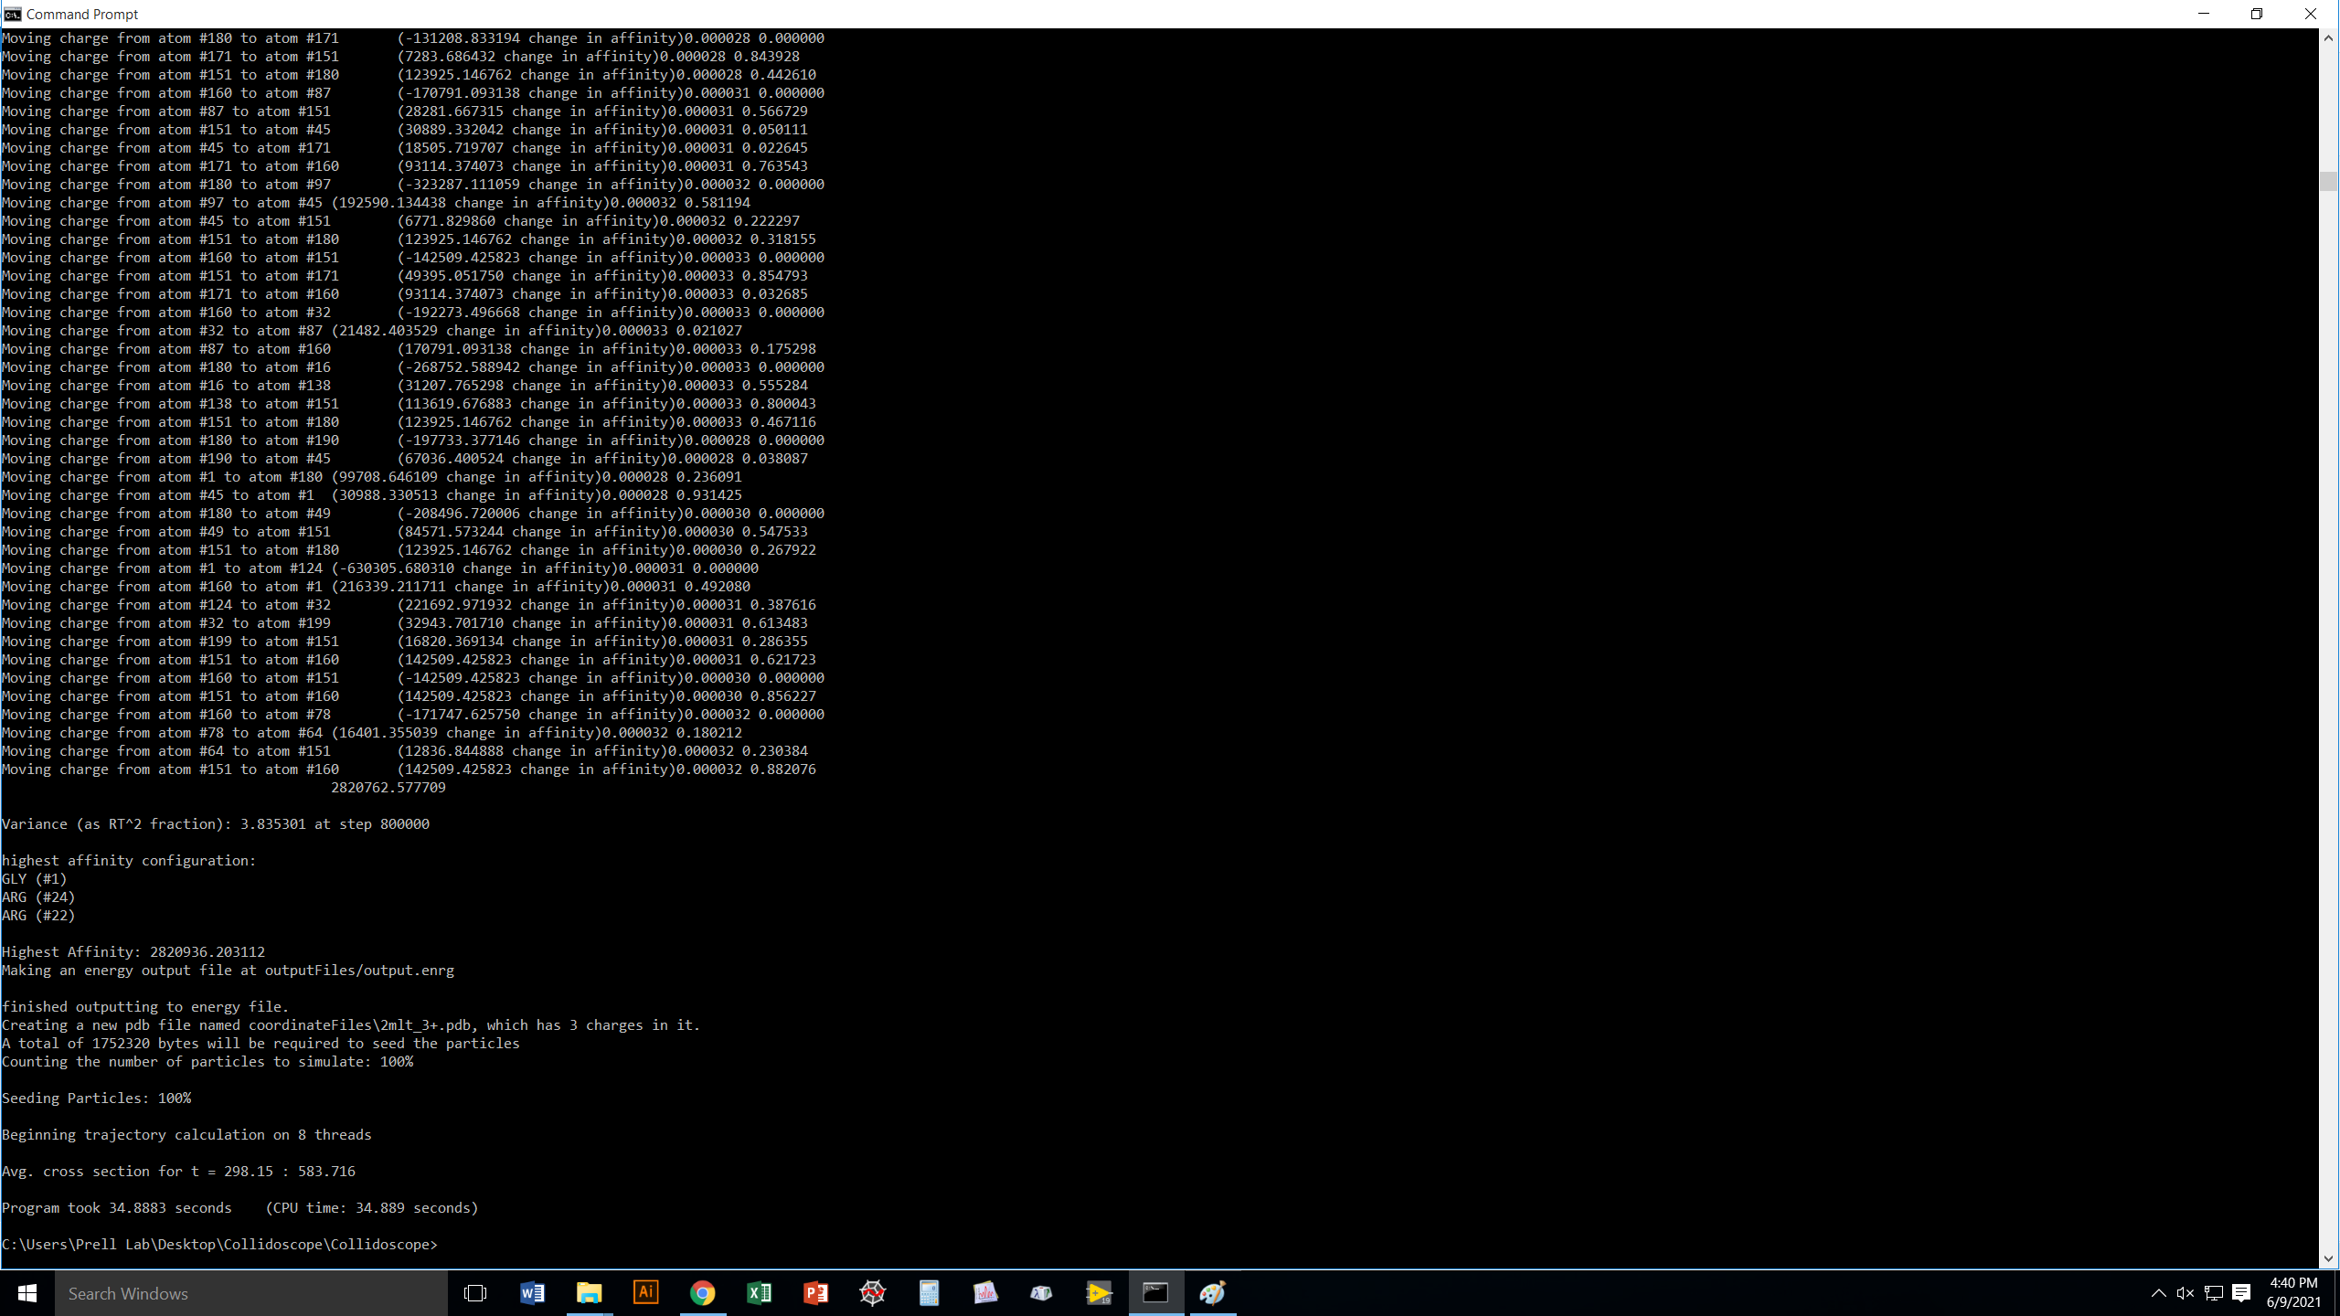
Yay, same result as when we did “place” and “CCS” separately
before!

Slide 36
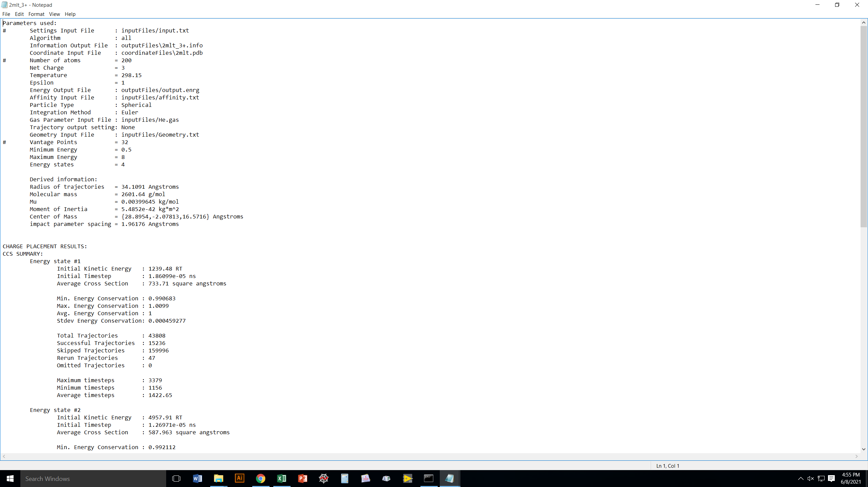
Alternatively, maybe you don’t care where the charges
should go on your protein, and you’re okay with them
being at the center of mass.
Without running “place”, and just doing “CCS” on the
original pdb file but with flag “-C 3”,
Collidoscope will put all 3 charges at the
center of mass of the protein/peptide.
That can be okay in many cases.

Slide 37
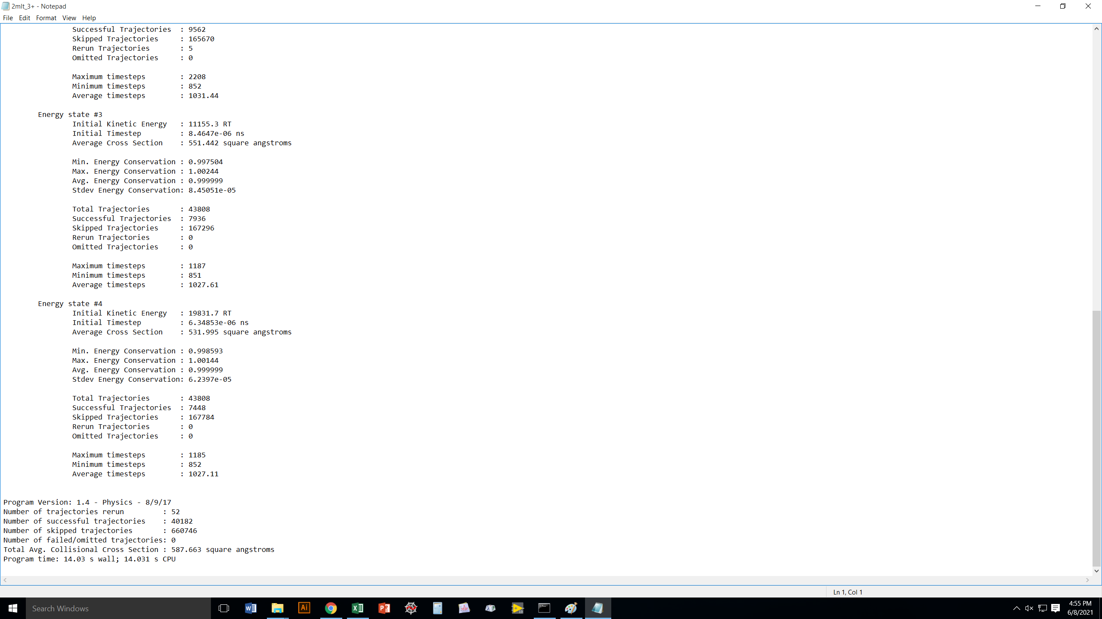
Slightly difference answer than when we did use
the “place” algorithm, but still very close.

Slide 38
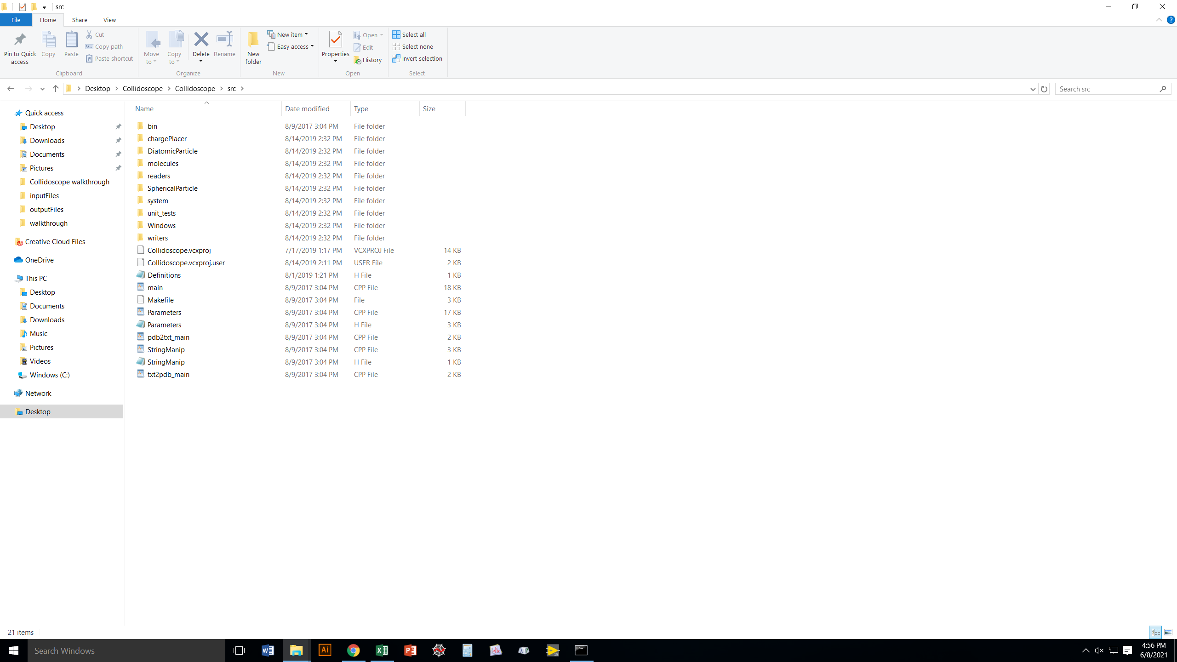
Once you become familiar with how
Collidoscope works, you may wish to
edit the source code and recompile
to suit your specific needs.
I strongly suggest storing the original
version of any source files in a secure
location so you can revert if need be!

Slide 39
Collidoscope
Thank you, and happy computing!

